Slide 1

Python

Slide 2
About Me
Conducted training sessions for 4500+Hrs for 3000+ participants at institutes, corporates & online on technologies like : BIG DATA & Hadoop Framework inclusive of its distributions, components & services, MySQL Administration, IBM DB2 Administration, Cloud computing, NoSQL DBs, Data Science & Virtual Hosting etc.
Delivered trainings with survey ratings of 95% and above as good/excellent with 100s of excellent remarks.
Certified Cloudera Hadoop Admin & EMC Data Scientist
Certified MySQL DBA
Certified IBM DB2 Apps & Systems DBA
PMP, RMP, ITIL foundation Certified
16+ years of total IT experience which includes working on various domains, various technologies and in various countries.
Experience
Certifications
AJAY
9+ years of total Training experience which includes delivering trainings at Institutes, corporates & through online medium for various Clients in Europe, Canada, USA, UK & India . Associated with various training/consulting/education providers such as Edureka , Simplilearn, Xpertised , NobleProg, Collabera, LearnSocial and many more.
Working as Senior Big Data & Cloud Systems Architect
Additionally : Freelance Trainer & Technical Consultant
Training
Role
Hosted many webinars on a self developed platform for “BIG DATA technologies and working with these technologies”
Welcome..

Slide 3
Introduction to Python
Notes:
Python is a high-level and general-purpose programming language along with being object-oriented and open source.

Slide 4
Python 2 made code development process easier than earlier versions.
It implemented technical details of Python Enhancement Proposal (PEP). Python 2.7 (last version in 2.x ) is no longer under development and in 2020 will be discontinued.

Slide 5
On December 2008, Python released version 3.0.
This version was mainly released to fix problems which exist in Python 2.
The nature of these change is such that Python 3 was incompatible with Python 2.
It is backward incompatible
Some features of Python 3 have been backported to Python 2.x versions to make the migration process easy in Python 3.
Notes:
As a result, for any organization who was using Python 2.x version, migrating their project to 3.x needed lots of changes. These changes not only relate to projects and applications but also all the libraries that form part of the Python ecosystem.

Slide 6
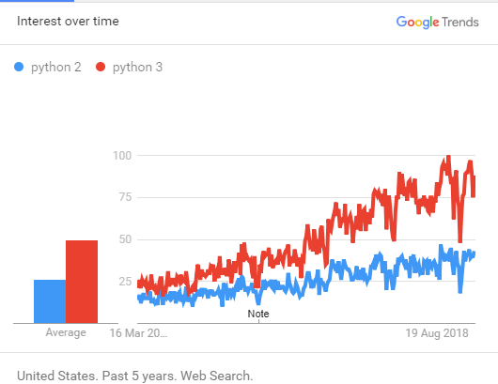
To become a DevOps engineer you need to work with configurations management tools like puppet or ansible. Here, you need to work with both of these versions.
If your company's code written in Python 2, you will require to learn to work with that.
If your development team is working on a project that depends on specific third-party libraries or software which you are not able to port to Python 3, then Python 2 is the only option available for you.
& many more….

Slide 7
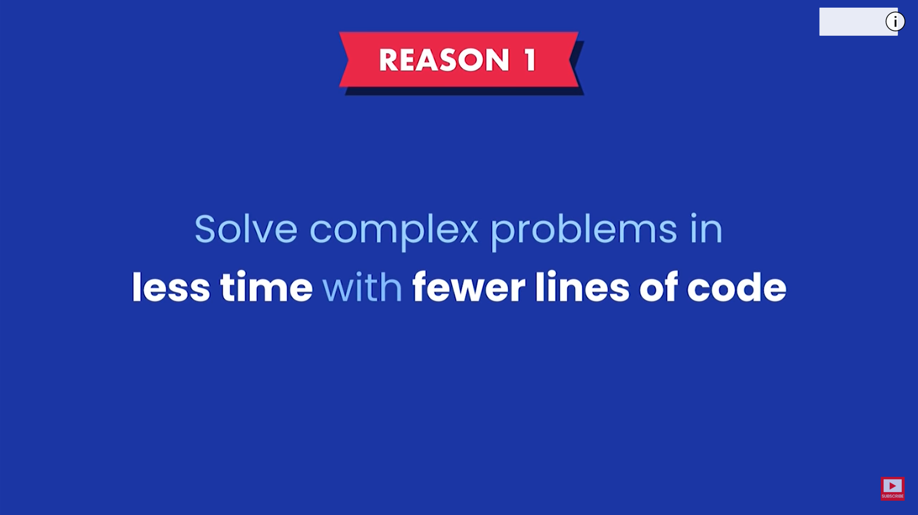

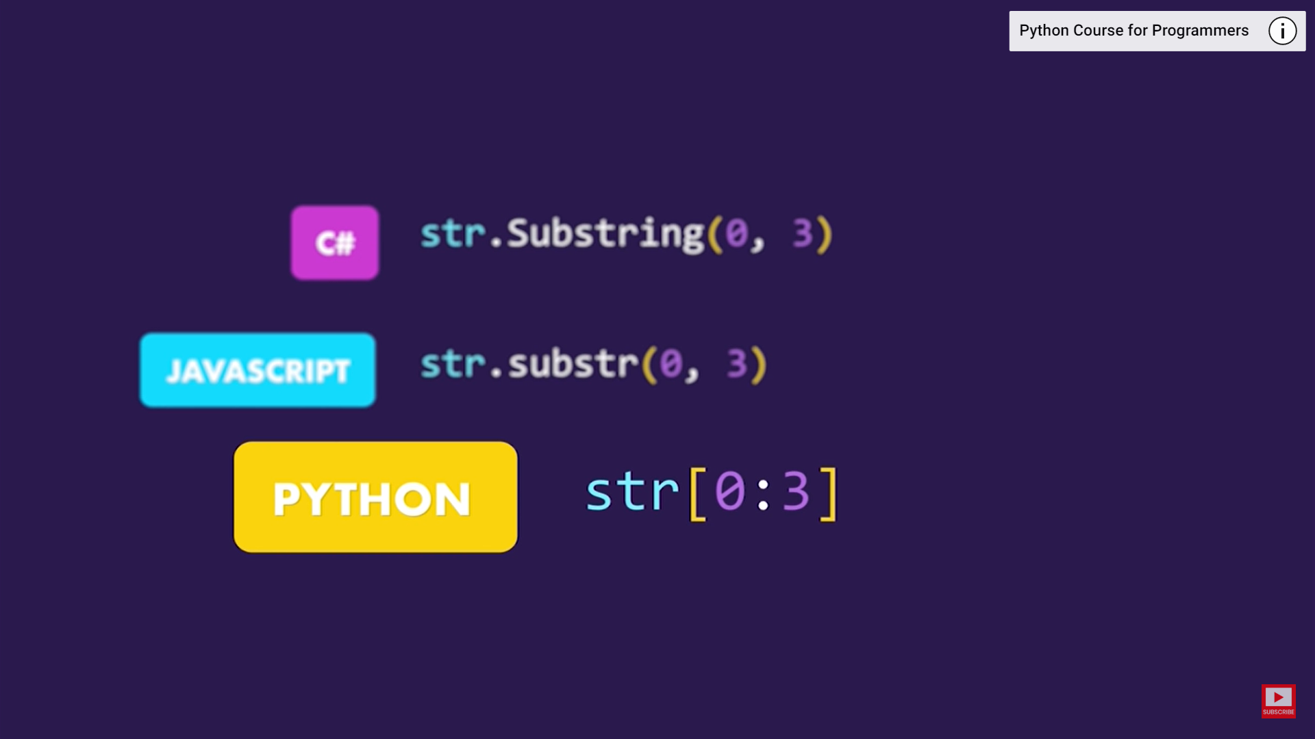

Slide 8
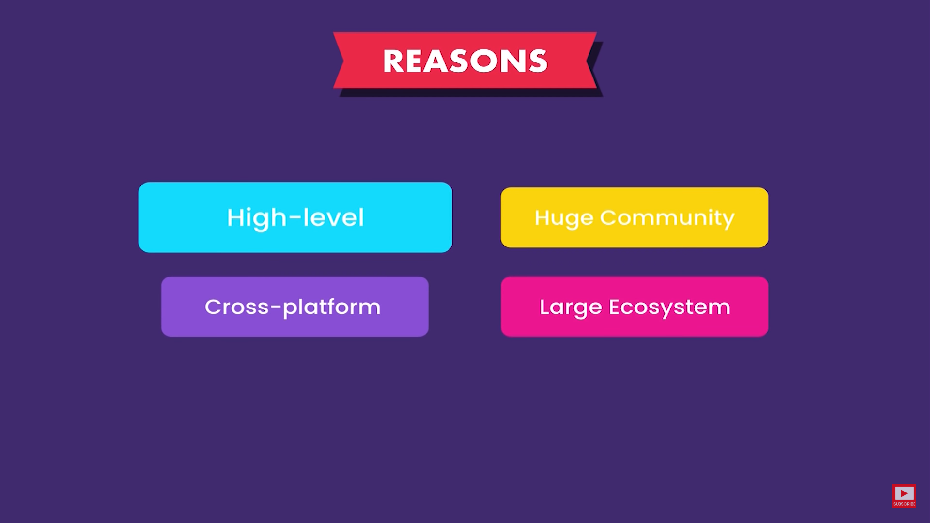

Notes:
High Level: We need not worry about complex tasks such as Memory Management in C++

Slide 9
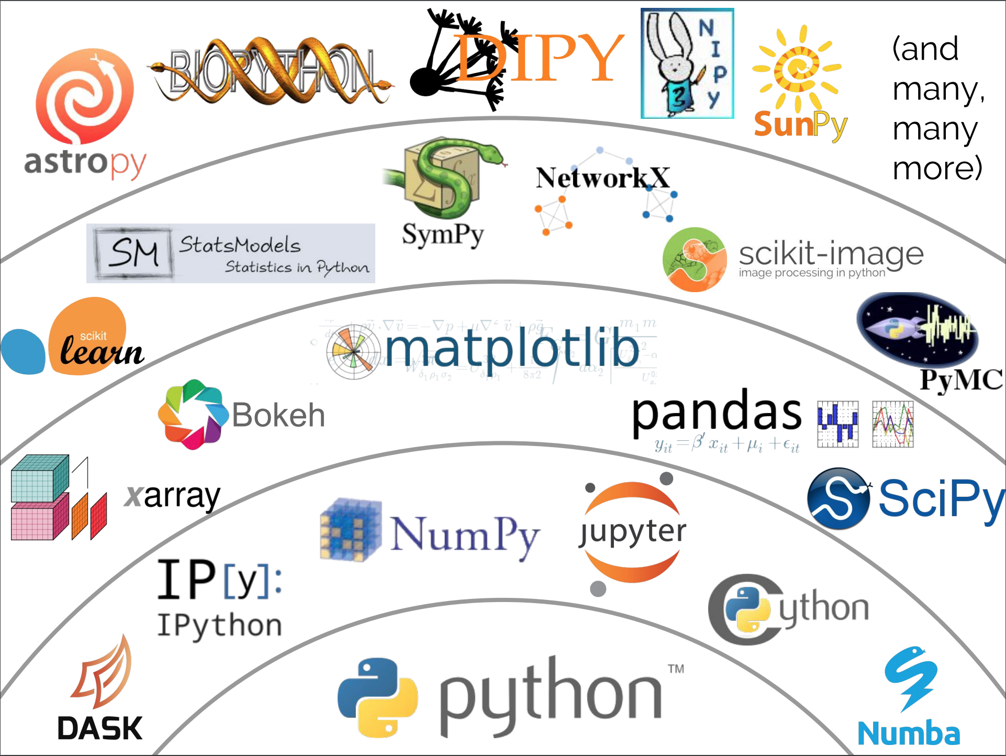
Prime reasons for using Python 3.x versions:
Python 3 supports modern techniques like AI, machine learning, and data science
Python 3 is supported by a large Python developer's community. Getting support is easy.
Its easier to learn Python language compared to earlier versions.
Offers Powerful toolkit and libraries
Mixable with other languages

Slide 10
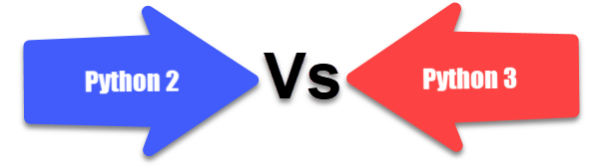
History of Python 2
Python 2.0 - October 16, 2000
Python 2.1 - April 17, 2001
Python 2.2 - December 21, 2001
Python 2.3 - July 29, 2003
Python 2.4 - November 30, 2004
Python 2.5 - September 19, 2006
Python 2.6 - October 1, 2008
Python 2.7-July 3, 2010
History of Python 3
Python 3.0 - December 3, 2008
Python 3.1 - June 27, 2009
Python 3.2 - February 20, 2011
Python 3.3 - September 29, 2012
Python 3.4-March 16, 2014
Python 3.5 - September 13, 2015
Python 3.6- October 2016
Python 3.7- June 2018.
Python 3.8- October 2019
Notes:
Python 2 is being used by 99.4% of websites, whereas Python 3 is being used only by 0.6% of websites.
Quick History
Version 1 of Python : Python 1.0 was released in January 1994. The major release included a number of new features and functional programming tools including lambda, filter, map and reduce. The version 1.4 was released with several new features like keyword arguments, built-in support for complex numbers, and a basic form of data hiding.
Version 2 of Python : In October 2000, Python 2.0 was released with the new list comprehension feature and a garbage collection system. The syntax for the list comprehension feature was inspired by other functional programming languages like Haskell. But Python 2.0, unlike Haskell, gave preference to alphabetic keywords over punctuation characters. Also, the garbage collection system effectuated collection of reference cycles. Further releases added a number of functionality to the programming language like support for nested scopes, and unification of Python’s classes and types into a single hierarchy. The Foundation will provide support to version 2.7 of the programming language till 2020.

Slide 11
Basis of comparison | Python 3 | Python 2
Release Date | 2008 | 2000
Function print | print ("hello") | print "hello"
Division of Integers | Whenever two integers are divided, you get a float value | When two integers are divided, you always provide integer value.
Unicode | In Python 3, default storing of strings is Unicode. | To store Unicode string value, you require to define them with "u".
Syntax | The syntax is simpler and easily understandable. | The syntax of Python 2 was comparatively difficult to understand.
Rules of ordering Comparisons | In this version, Rules of ordering comparisons have been simplified. | Rules of ordering comparison are very complex.
Notes:
Version 3 of Python : Python 3.0 was released in December 2008. It came with a several new features and enhancements, along with a number of deprecated features. The deprecated features and backward incompatibility make version 3 of Python completely different from earlier versions. So many Python developers still use Python 2.6 or 2.7 to avail the features deprecated from last major release. However, the new features made it more modern and popular.
Python 3.0 replaced print statement with the built-in print() function, while allowing programmers to use custom separator between lines.
Likewise, it simplified the rules of ordering comparison.
If the operands are not organized in a natural and meaningful order, the ordering comparison operators can now raise a TypeError exception.
The version 3 of the programming language further uses text and data instead of Unicode and 8-bit strings. While treating all code as Unicode by default it represents binary data as encoded Unicode.
As Python 3 is backward incompatible, the programmers cannot access features like string exceptions, old-style classes, and implicit relative imports. Also, the developers must be familiar with changes made to syntax and APIs. They can use a tool called “2to3” to migrate their application from Python 2 to 3 smoothly. The tool highlights incompatibility and areas of concern through comments and warnings. The comments help programmers to make changes to the code, and upgrade their existing applications to the latest version of programming language.

Slide 12
Basis of comparison | Python 3 | Python 2
Iteration | The new Range() function introduced to perform iterations. | In Python 2, the xrange() is used for iterations.
Exceptions | It should be enclosed in parenthesis. | It should be enclosed in notations.
Leak of variables | The value of variables never changes. | The value of the global variable will change while using it inside for-loop.
Backward compatibility | Not difficult to port python 2 to python 3 but it is never reliable. | Python version 3 is not backwardly compatible with Python 2.
Library | Many recent developers are creating libraries which you can only use with Python 3. | Many older libraries created for Python 2 is not forward-compatible.
Notes:
Latest Versions of Python : At present, programmers can choose either version 3.4.3 or 2.7.10 of Python.
Python 2.7 enables developers to avail improved numeric handling and enhancements for standard library.
The version further makes it easier for developers to migrate to Python 3.
On the other hand, Python 3.4 comes with several new features and library modules, security improvements and CPython implementation improvements.

Slide 13
Installation & Setup Options

Slide 14
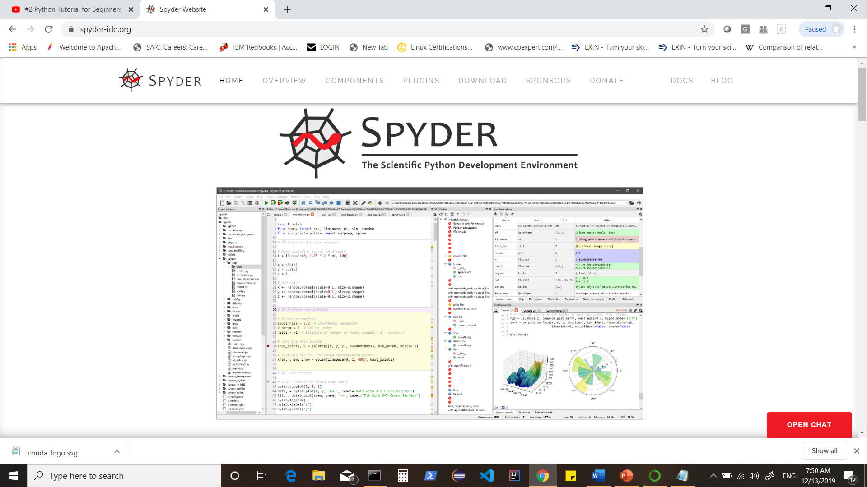
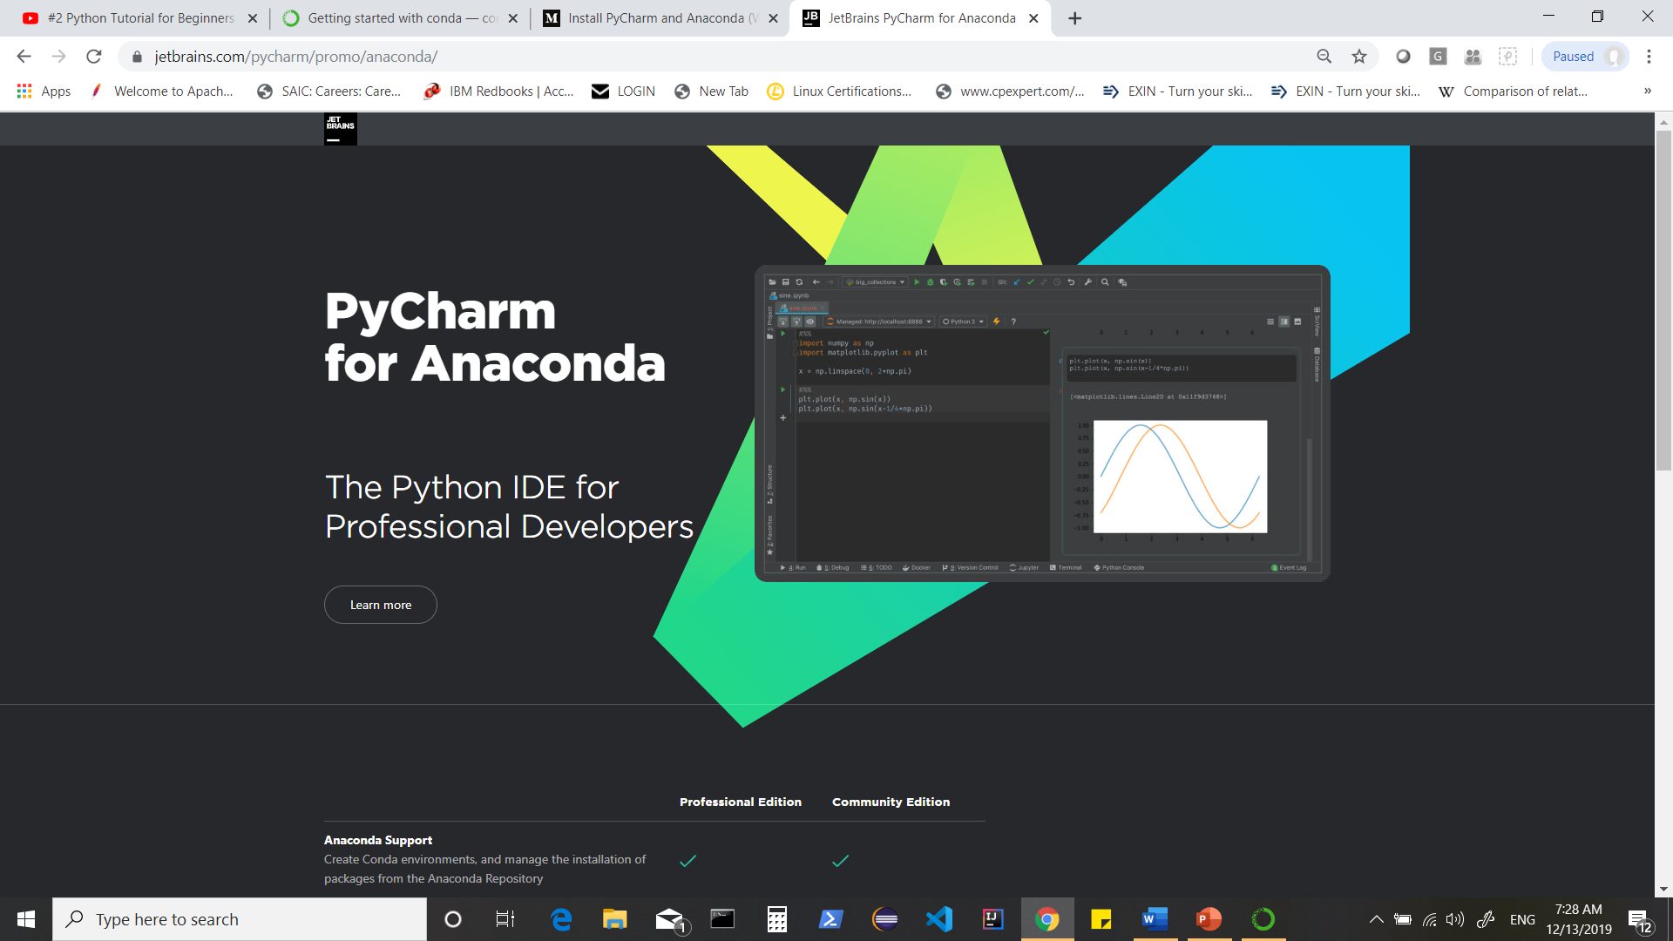
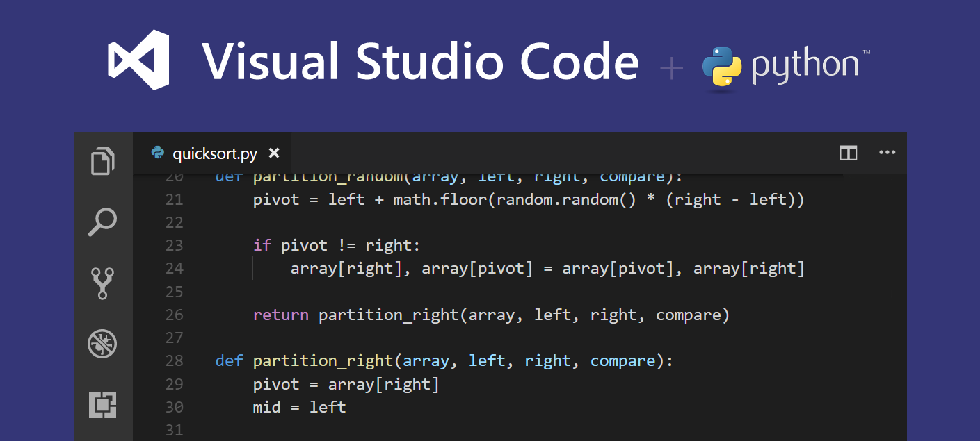
Notes:
https://www.jetbrains.com/pycharm/promo/anaconda/
https://code.visualstudio.com/docs/languages/python
https://www.spyder-ide.org/

Slide 15
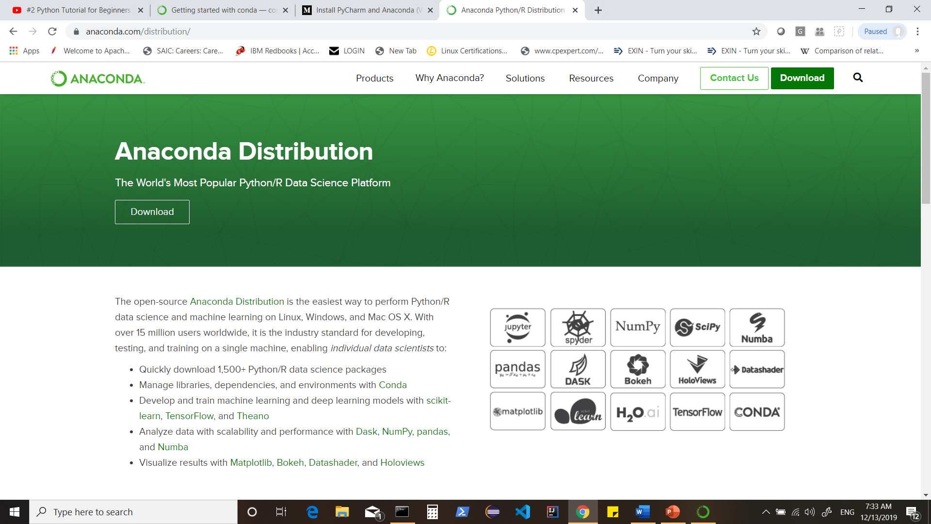
Notes:
https://www.anaconda.com/distribution/

Slide 16
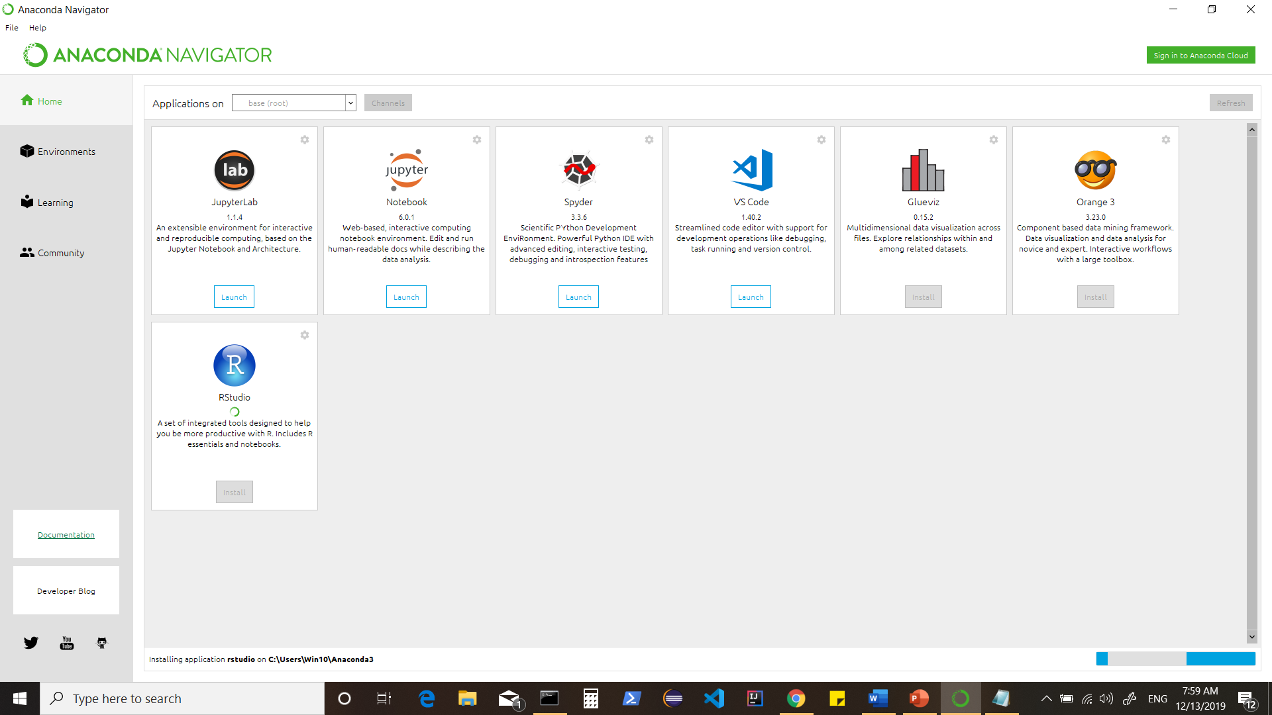

Slide 17
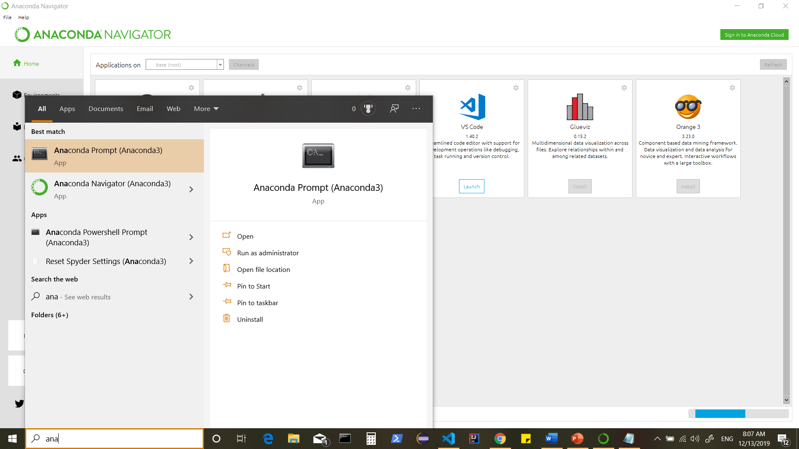
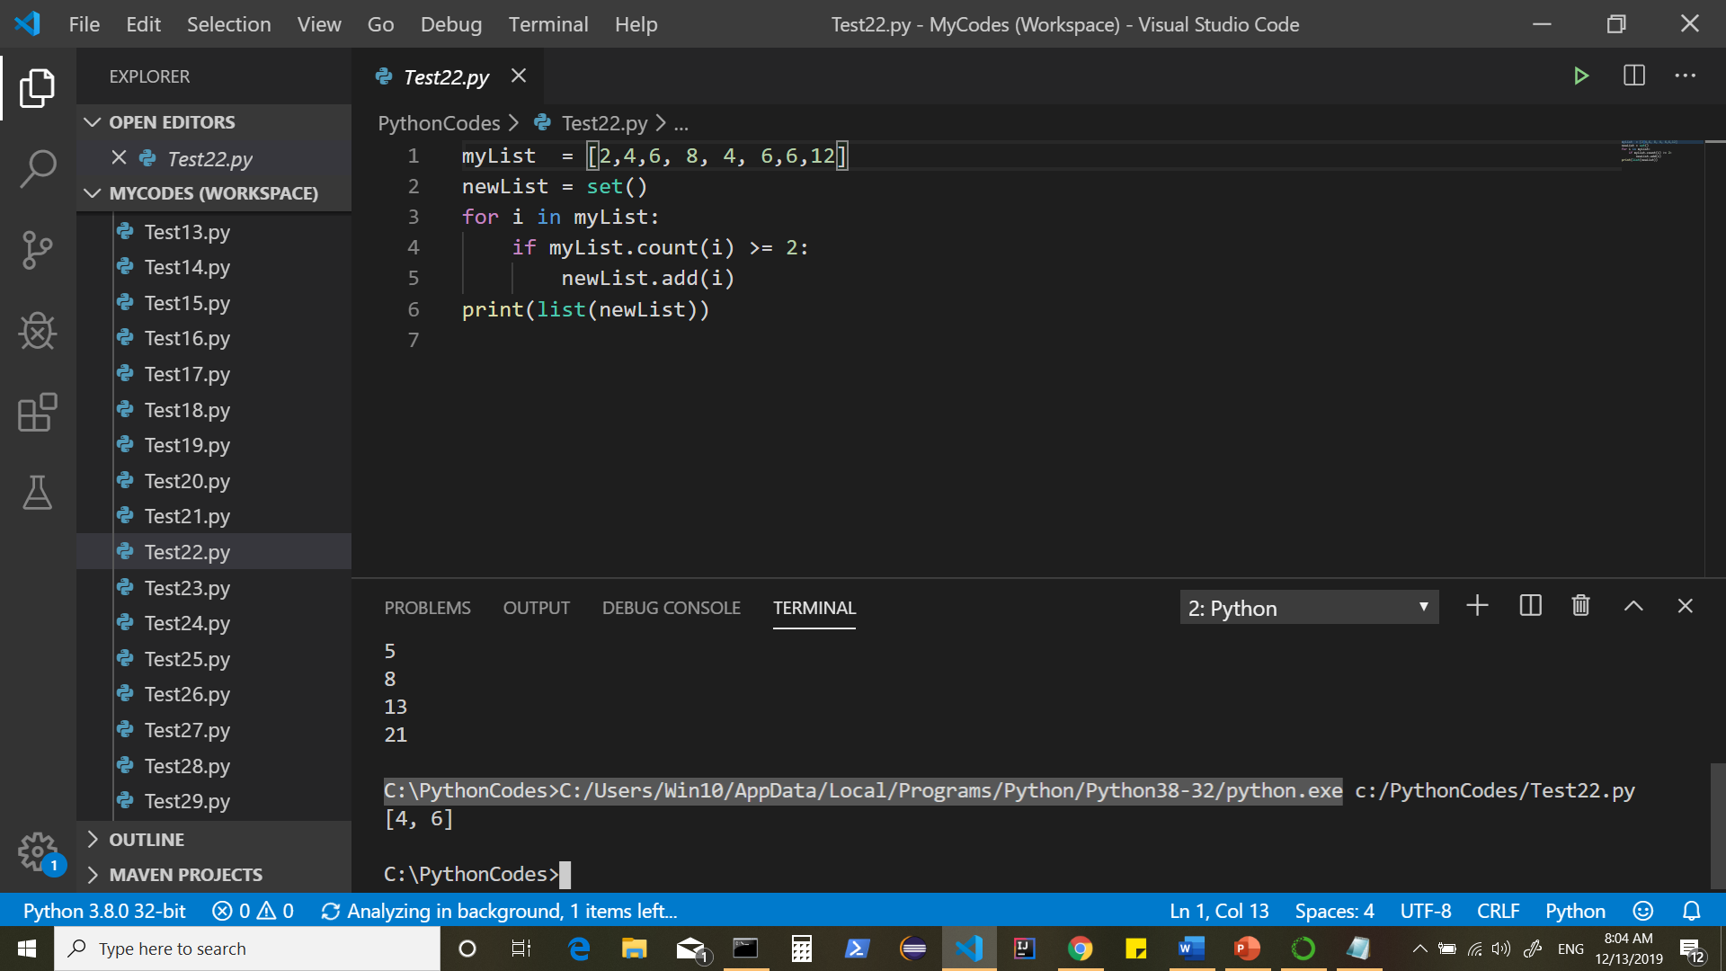
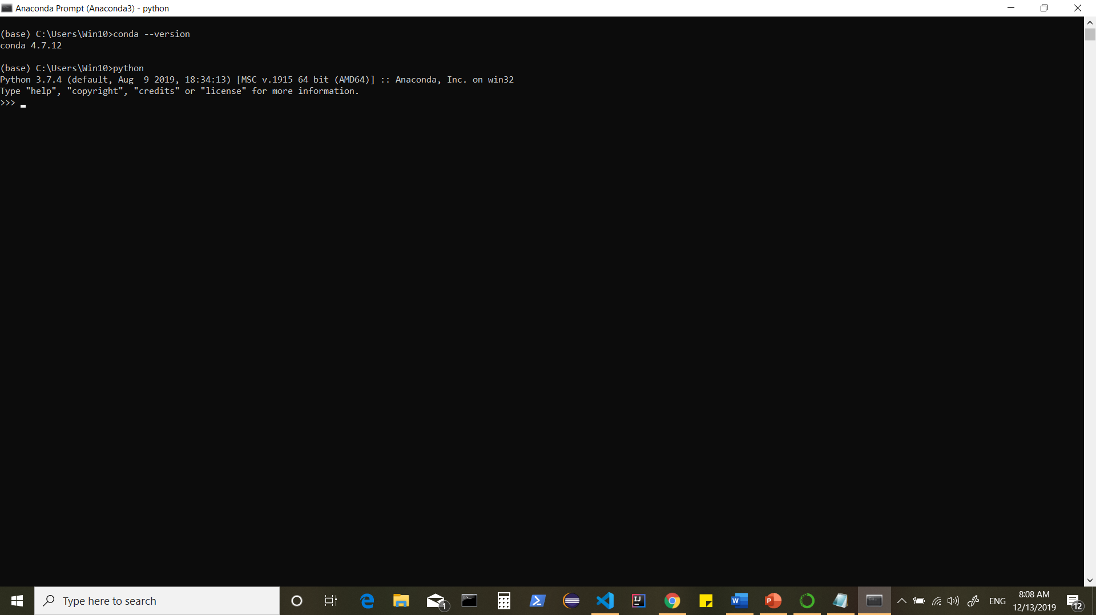

OR
OR
Notes:
C:\PythonCodes>C:/Users/Win10/AppData/Local/Programs/Python/Python38-32/python.exe

Slide 18
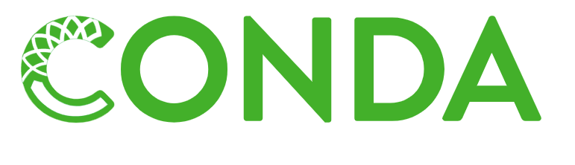
Package, dependency and environment management for any language---Python, R, Ruby, Lua, Scala, Java, JavaScript, C/ C++, FORTRAN
Conda is an open source package management system and environment management system
Quickly installs, runs and updates packages and their dependencies.
Easily creates, saves, loads, and switches between environments .
Was created for Python programs but it can package and distribute software for any language.
As a package manager helps you find and install packages.
If you need a package that requires a different version of Python, without switching to a different environment manager you can set up a totally separate environment to run different version of Python.
It can install and manage the thousand packages at repo.continuum.io that are built, reviewed and maintained by Anaconda.
Can be combined with continuous integration systems such as Travis CI and AppVeyor to provide frequent, automated testing of your code.
Notes:
https://conda.io/en/latest/

Slide 19
Python Editors

Slide 20
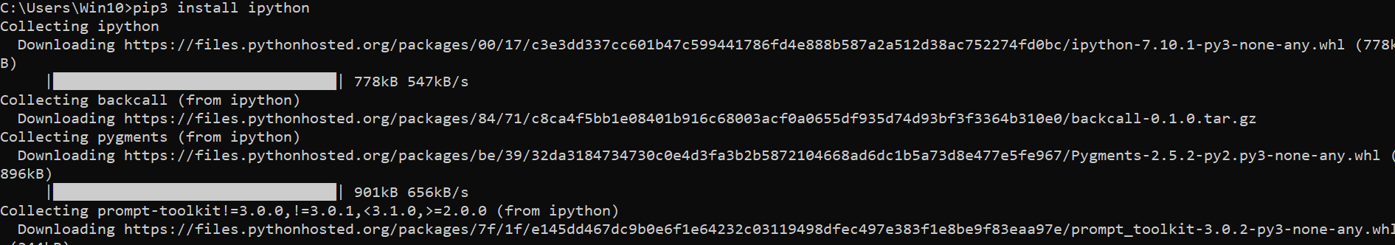
Ipython
IPython stands for Interactive Python. Created by Fernando Perez in 2001, IPython is an enhanced read-eval-print loop (REPL) environment particularly suitable for scientific computing.
It offers a fully compatible replacement for the standard Python interpreter, with convenient shell features, special commands, command history mechanism and output results caching.
Use pip3 command which is the in-built Python package installer.

Slide 21
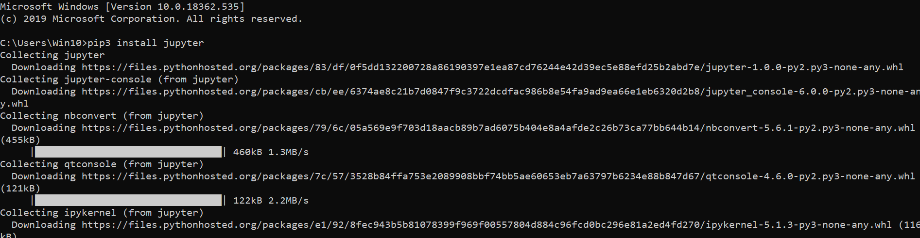
Jupyter Notebook (client-server application)
The Jupyter Notebook is a browser-based graphical interface to the IPython shell. It allows the user to include formatted text, static and dynamic visualizations, mathematical equations, JavaScript widgets etc. along with the Python code.
The Jupyter Notebook document can be exported to PDF, Python script or HTML.
By default, the IPython kernel drives the Jupyter Notebook application.
It also supports other languages like Julia and R. (Jupyter stands for JUlia, PYThon and R).
Notes:
The interface is similar to IPython shell. However, there are a lot of other advantages.
For instance, you can insert and delete cells. A cell can contain code, heading or a markdown text which acts as documentation. The code in any cell can be run. Another advantage is that data visualizations generated by libraries like Matplotlib can be incorporated inline.
The notebook is saved with the .ipynb extension. It can be exported to HTML or PDF format so that it can be shared.

Slide 22
Virtual Environment
Many times, Python packages developed by certain third-parties have to be installed while developing Python-based applications. However, requirement for a specific version of the same package may sometimes be conflicting with other applications' requirements.
Hence, it is desired to have side-by-side environments for each purpose to avoid compatibility issues. This is achieved by setting up a virtual environment.
The venv module in a standard Python library used to create virtual environments.
C:\Python36>python -m venv c:\myvenv
Use Conda to setup VENV
Notes:
This will create c:\myvenv and directories inside it containing a copy of the Python interpreter, the standard library, and other supporting files.
To activate the environment run a batch file called activate.bat in the scripts subdirectory. The name of the current environment appears on the left side of the windows command prompt.
Now you can run a local copy of the Python interpreter from the command prompt.
Using online free available shells.

Slide 23
Python libraries
1. Requests: The most famous http library written by kenneth reitz.
2. Scrapy: If you are involved in webscraping then this is a must have library for you.
3. wxPython: A gui toolkit for python. An be used in place of tkinter.
4. Pillow: A friendly fork of PIL (Python Imaging Library). It is more user friendly than PIL and is a must have for anyone who works with images.
5. SQLAlchemy: A database library.

Slide 24
6. BeautifulSoup: Slow but for xml and html parsing library is very useful for beginners.
7. Twisted: The most important tool for any network application developer. It has a very beautiful api and is used by a lot of famous python developers.
8. NumPy: Provides some advance math functionalities to python.
9. SciPy: When we talk about NumPy then we have to talk about scipy. It is a library of algorithms and mathematical tools for python and has caused many scientists to switch from ruby to python.
10. matplotlib: A numerical plotting library. It is very useful for any data scientist or any data analyzer.

Slide 25
11. Pygame: This library will help you achieve your goal of 2d game development.
12. Pyglet: A 3d animation and game creation engine. This is the engine in which the famous python port of minecraft was made.
13. pyQT: A GUI toolkit for python. Usually a second choice after wxpython for developing GUI’s for python scripts.
14. pyGtk: Another python GUI library. It is the same library in which the famous Bittorrent client is created.
15. Scapy: A packet sniffer and analyzer for python made in python.

Slide 26
16. pywin32: A python library which provides some useful methods and classes for interacting with windows.
17. nltk: Natural Language Toolkit : It is a very useful library if you want to manipulate strings. But it’s capacity is beyond that.
18. nose: A testing framework for python. It is used by millions of python developers. It is a must have if you do test driven development.
19. SymPy: SymPy can do algebraic evaluation, differentiation, expansion, complex numbers, etc. It is contained in a pure Python distribution.
20. Ipython: It is a python prompt on steroids. It has completion, history, shell capabilities, and a lot more.

Slide 27
TensorFlow
Scikit-Learn
Keras
PyTorch
LightGBM
Eli5
Theano
Pandas etc..

Slide 28
Basics of Python Scripting

Slide 29
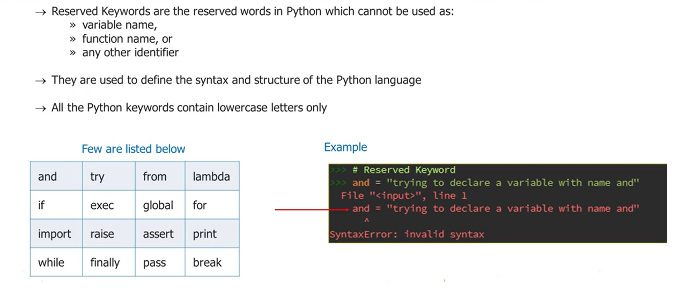

Slide 30
Reserved Words : cannot be used as a variable name, function name or any other identifier.
and
del
from
not
while
as
elif
global
or
with
assert
else
if
pass
yield
break
except
import
print
class
exec
in
nonlocal
raise
continue
finally
is
return
def
for
lambda
try
False
None
True
Notes:
Python vocabulary is very small i.e. “The reserved words” (words that have special meaning to Python)
We can create our own words which we call as Variables. Python’s reserved words cannot be used for variables.

Slide 31
Python Identifiers
Apart from keywords, a Python program can have variables, functions, classes, modules, packages etc. Identifier is the name given to these programming elements.
An identifier should start with either an alphabet letter (lower or upper case) or an underscore (_). After that, more than one alphabet letters (a-z or A-Z), digits (0-9) or underscores may be used to form an identifier. No other characters are allowed.
Conventionally, the name of the class begins with an uppercase alphabet letter. Others start with lowercase alphabet letters.
Use of one or two underscore characters has a special significance when naming the instance attributes of a class.
Two leading and trailing underscores are used in the language itself for a special purpose.
For example (e.g. __add__, __init__)

Slide 32
Indents in Python
Many times it is required to construct a block of more than one statements.
For example there are usually multiple statements that are part of the definition of a function.
There can be one or more statements in a looping construct.
Different programming languages use different techniques to define the scope and extent of a block of statements in constructs like class, function, conditional and loop. In C, C++, C# or Java, statements inside curly brackets { and } are treated as a block.
Python uses uniform indentation to denote a block of statements.

Slide 33
Variables
Any value of certain type is stored in the computer's memory for processing. Out of available memory locations, one is randomly allocated for storage. In order to conveniently and repeatedly refer to the stored value, it is given a suitable name.
Note**Remember that a variable is a name given to a value, and not to a memory location storing the value.
Dynamic Typing
One of the important features of Python is that it is a dynamically-typed language. Programming languages such as C, C++, Java, and C# are statically-typed languages. A variable in these languages is a user-friendly name given to a memory location and is intended to store the value of a particular data type.
A variable in Python is not bound permanently to a specific data type. Instead, it only serves as a label to a value of a certain type. The data assigned to a variable decides its data type and not the other way around.

Slide 34
Working With Structured Data

Slide 35
NUMPY

Slide 36
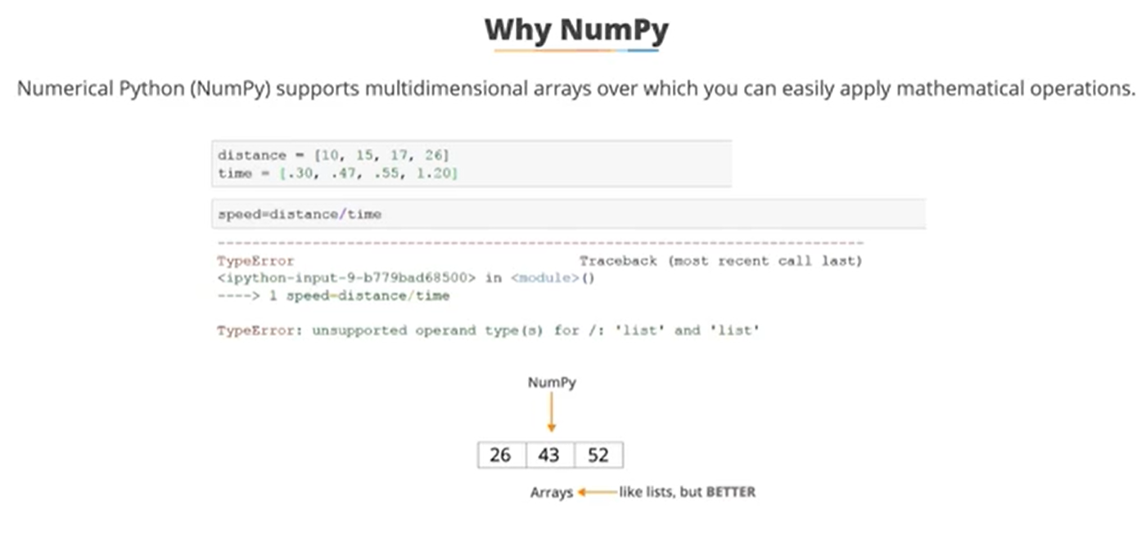
Numpy: Python Library that support data containers called Arrays (Arrays can achieve what lists can’t such as applying mathematical operations to entire dataset)

Slide 37
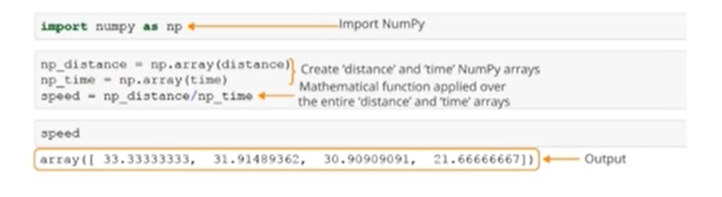

Slide 38


Slide 39
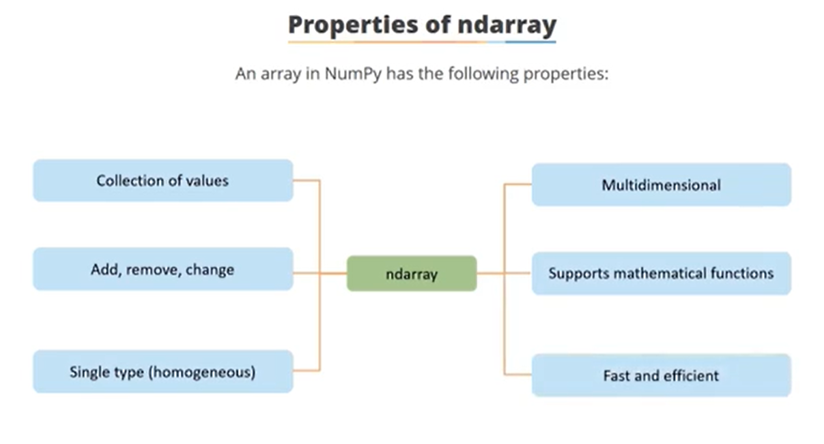

Slide 40
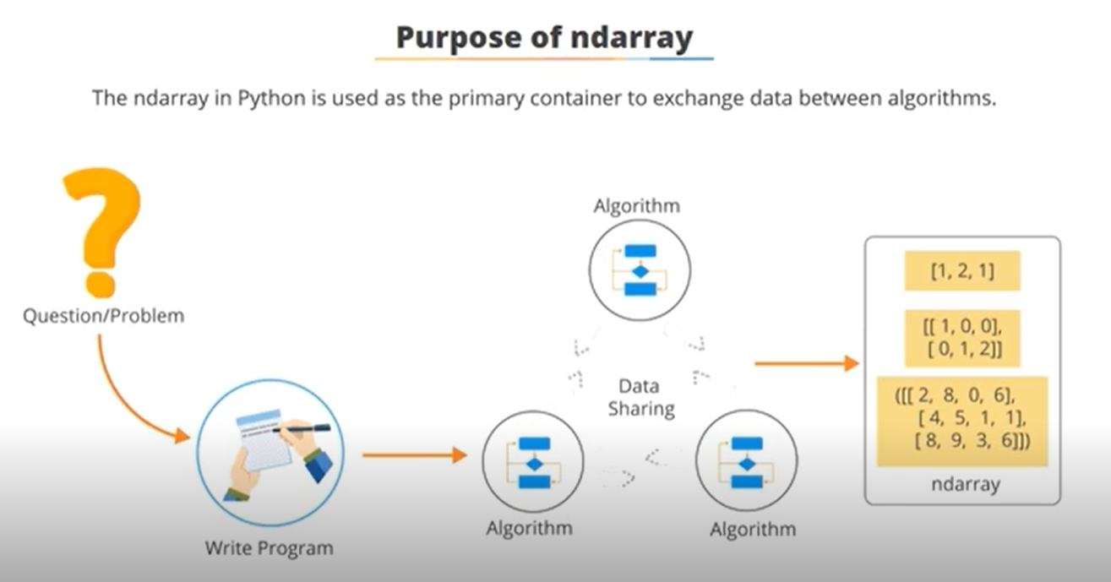

Slide 41
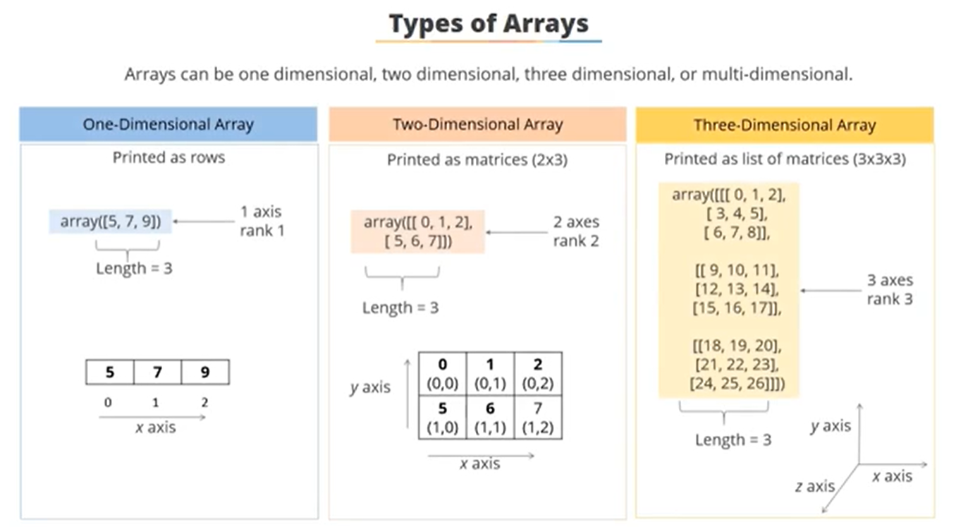

Slide 42
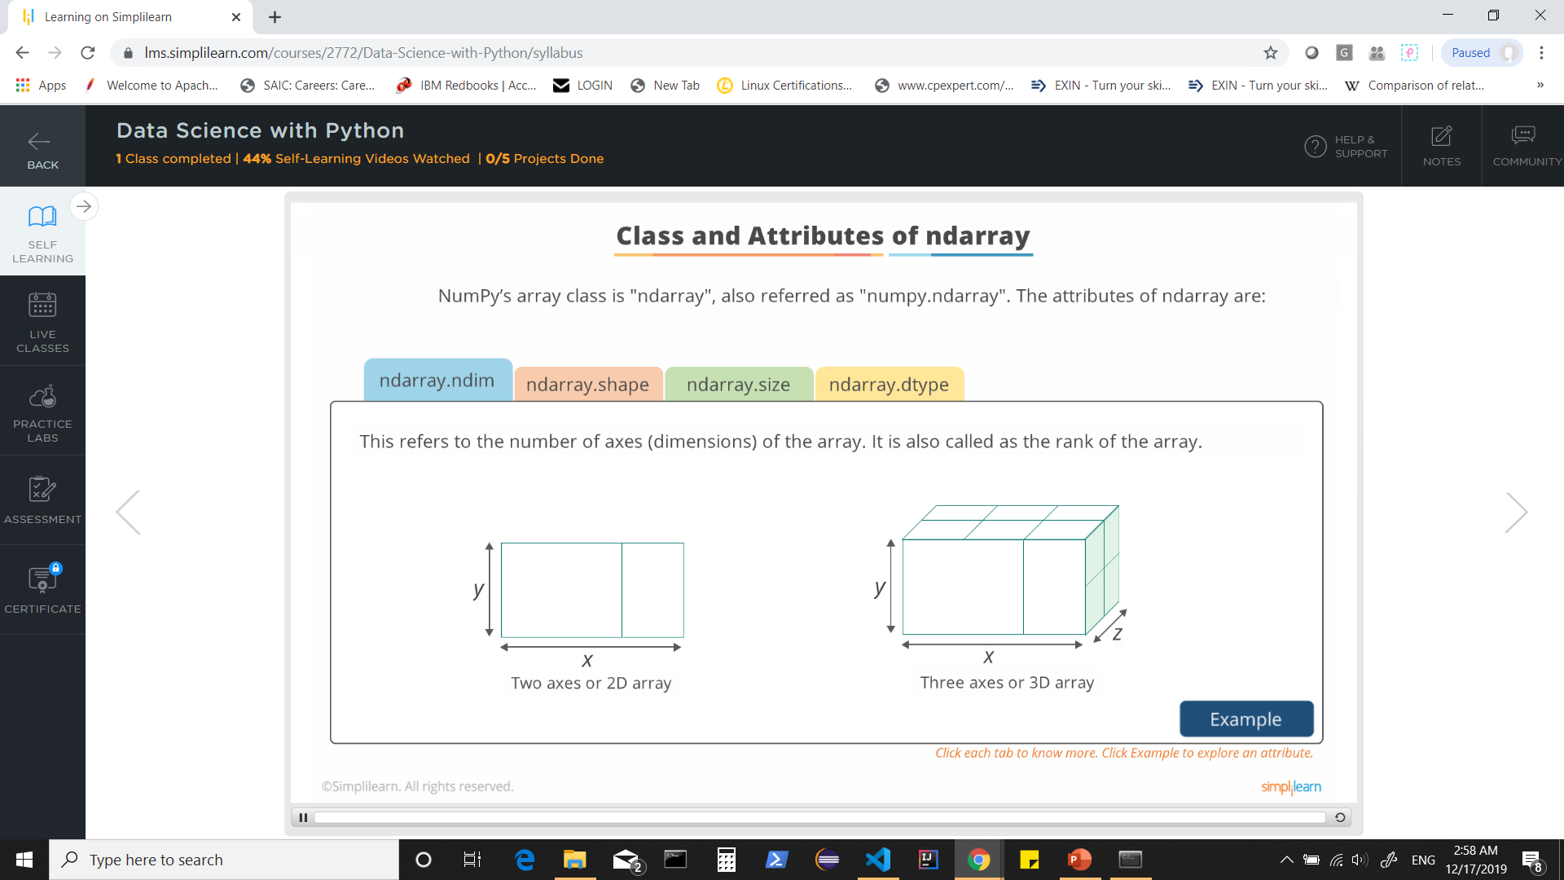


Slide 43

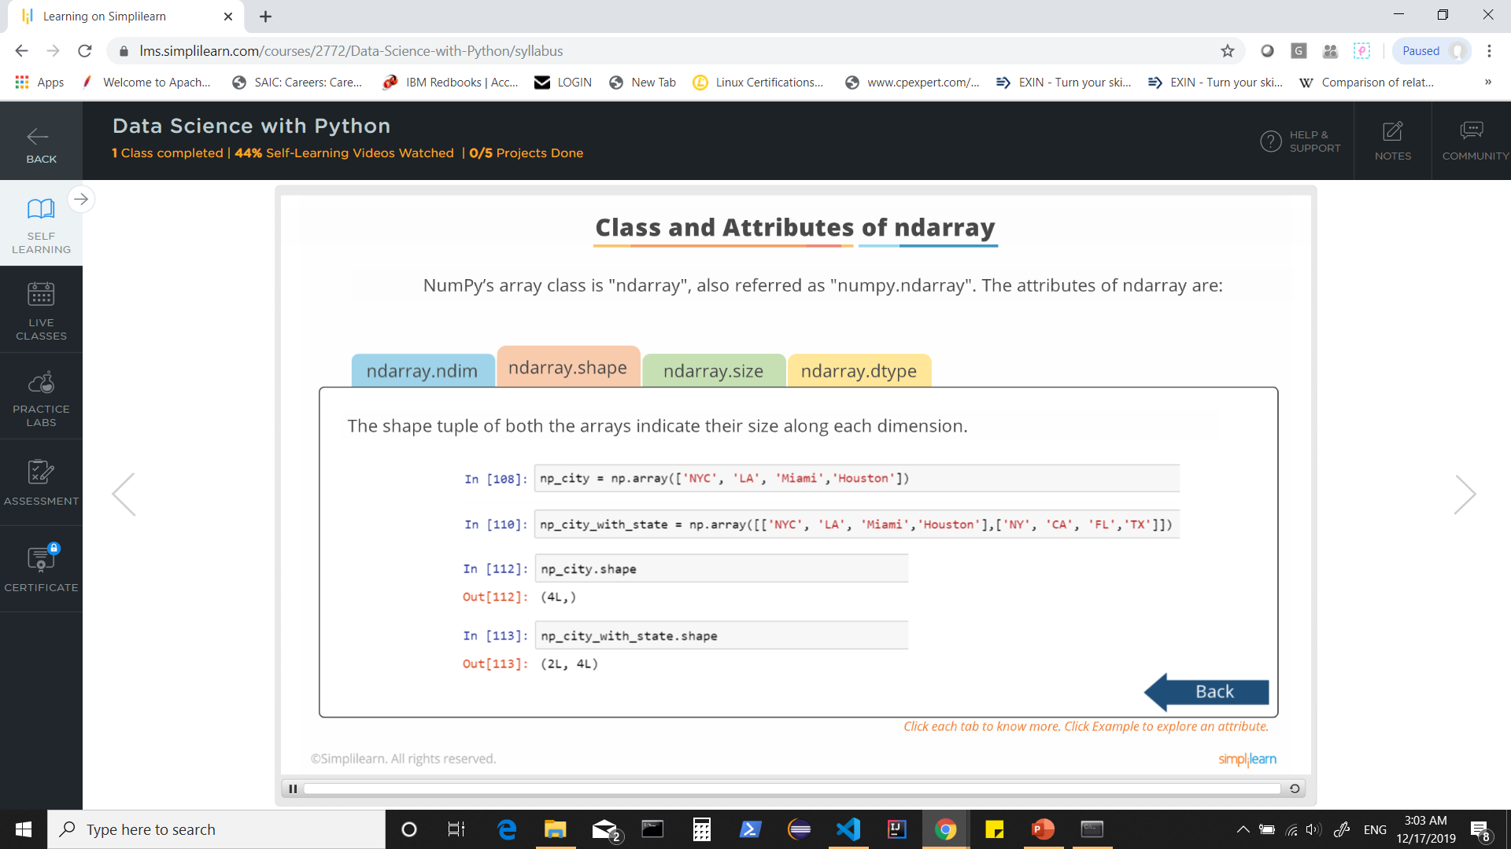

Slide 44

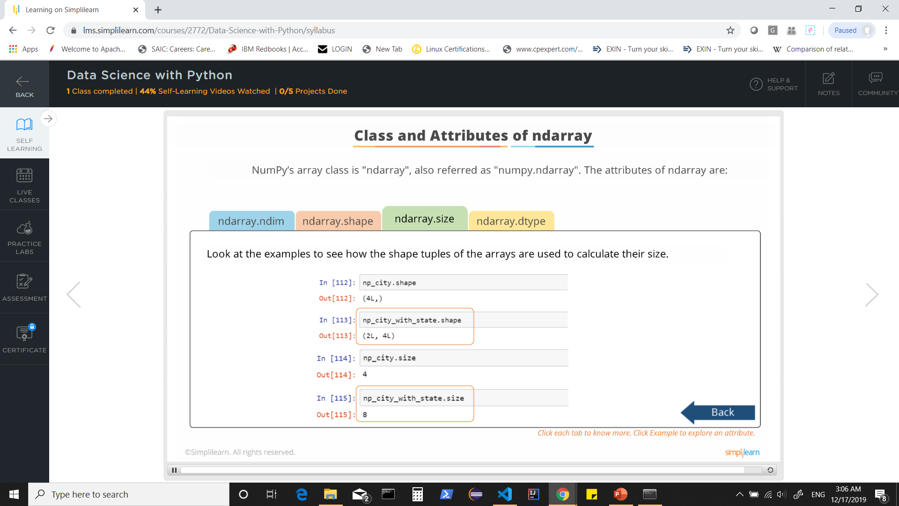

Slide 45
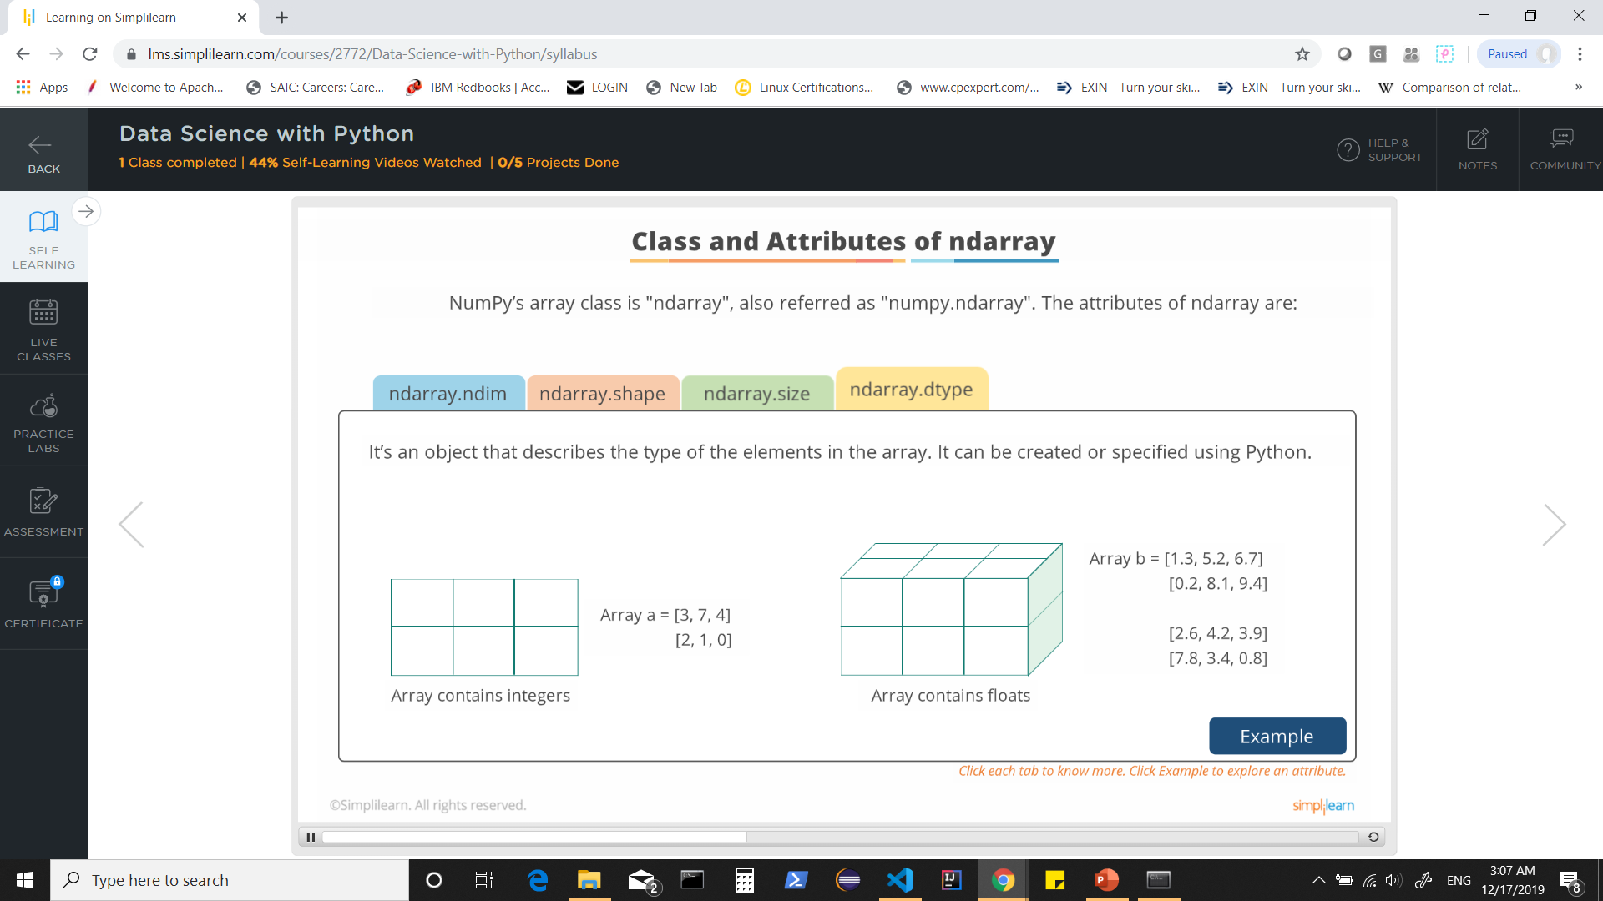


Slide 46
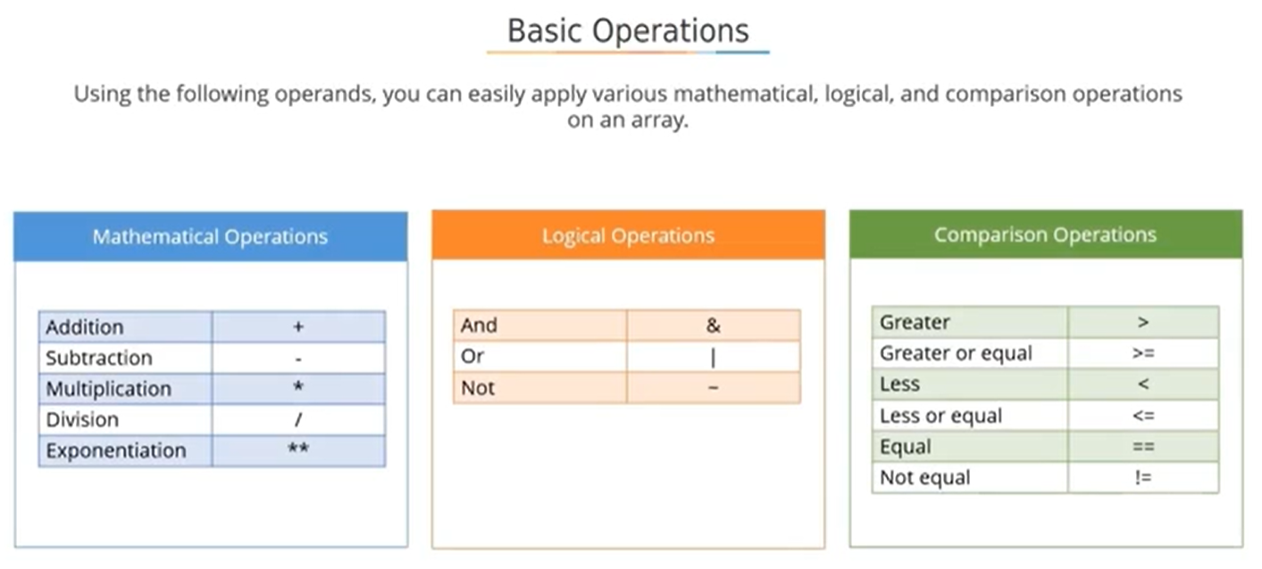

Slide 47
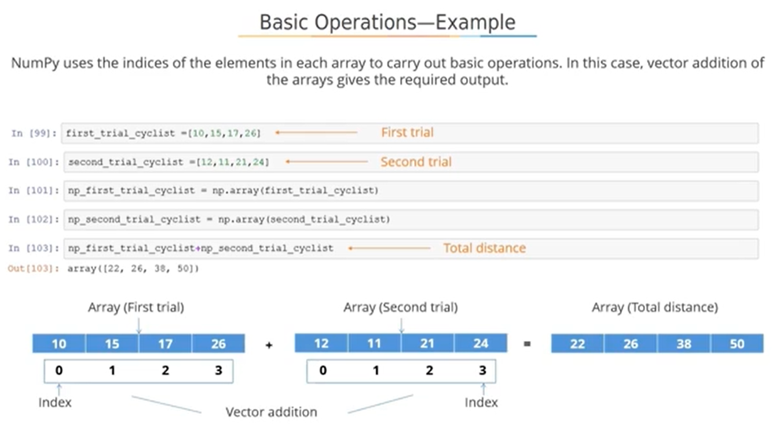

Slide 48
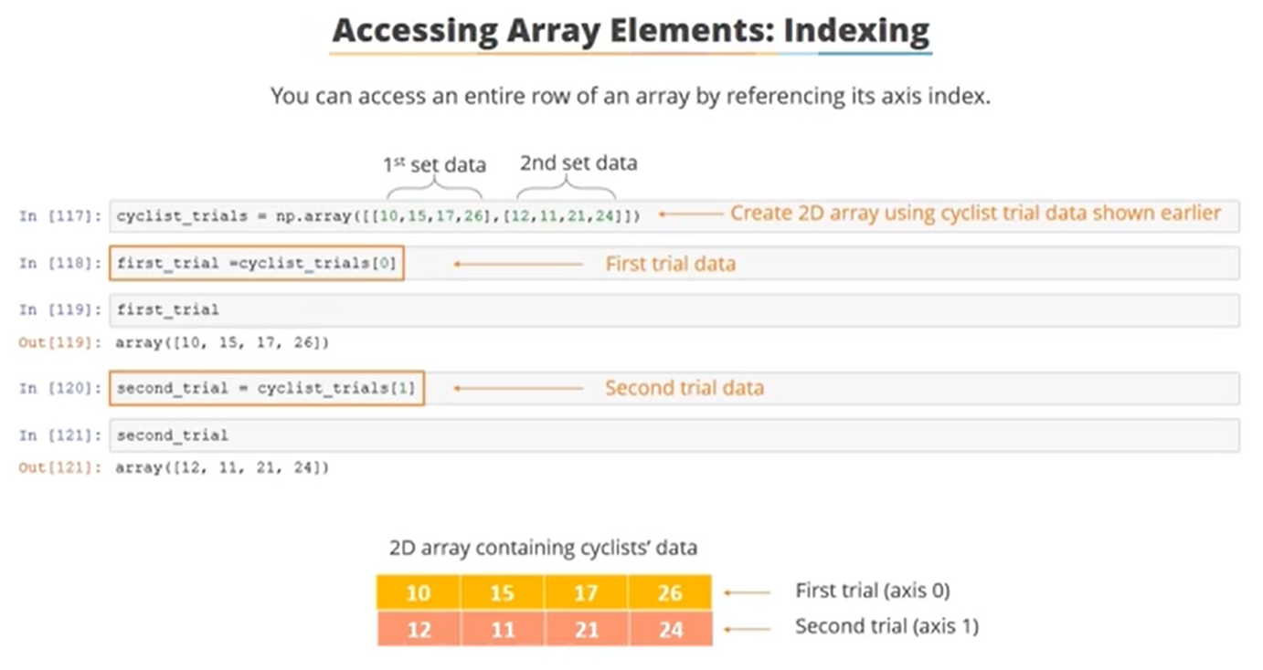

Slide 49
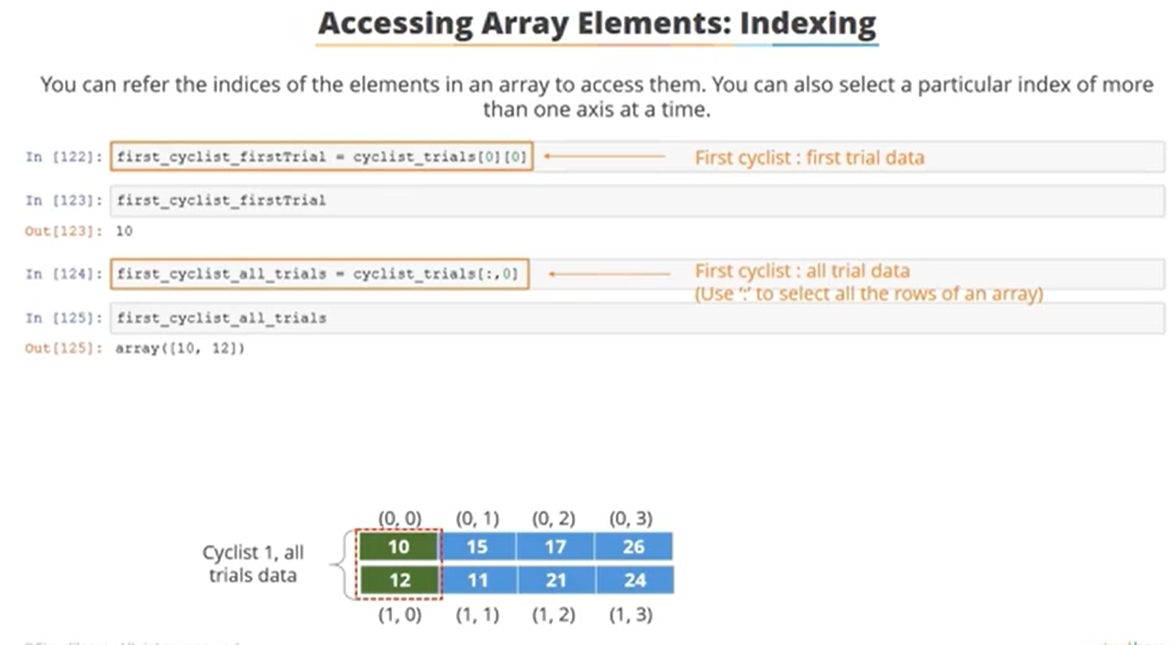

Slide 50
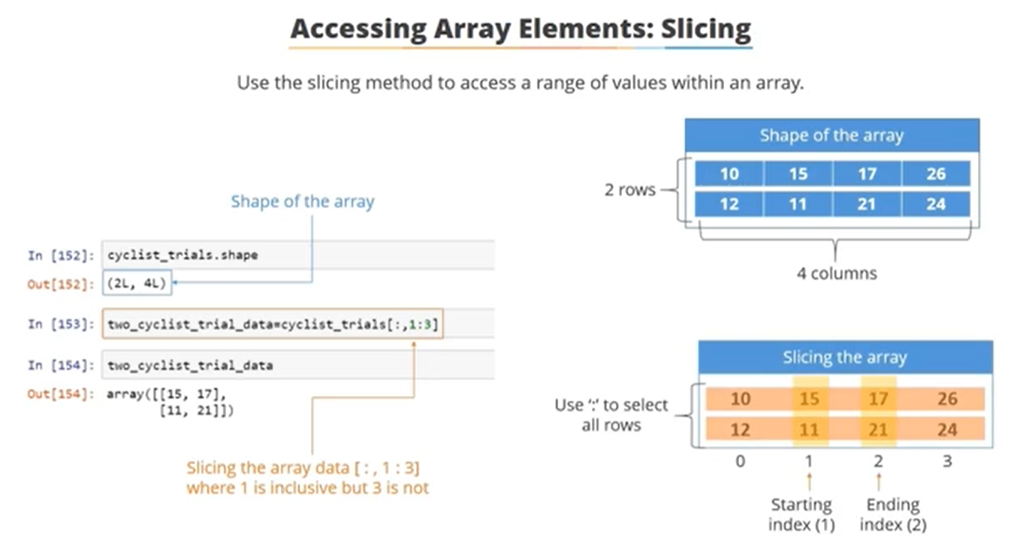

Slide 51
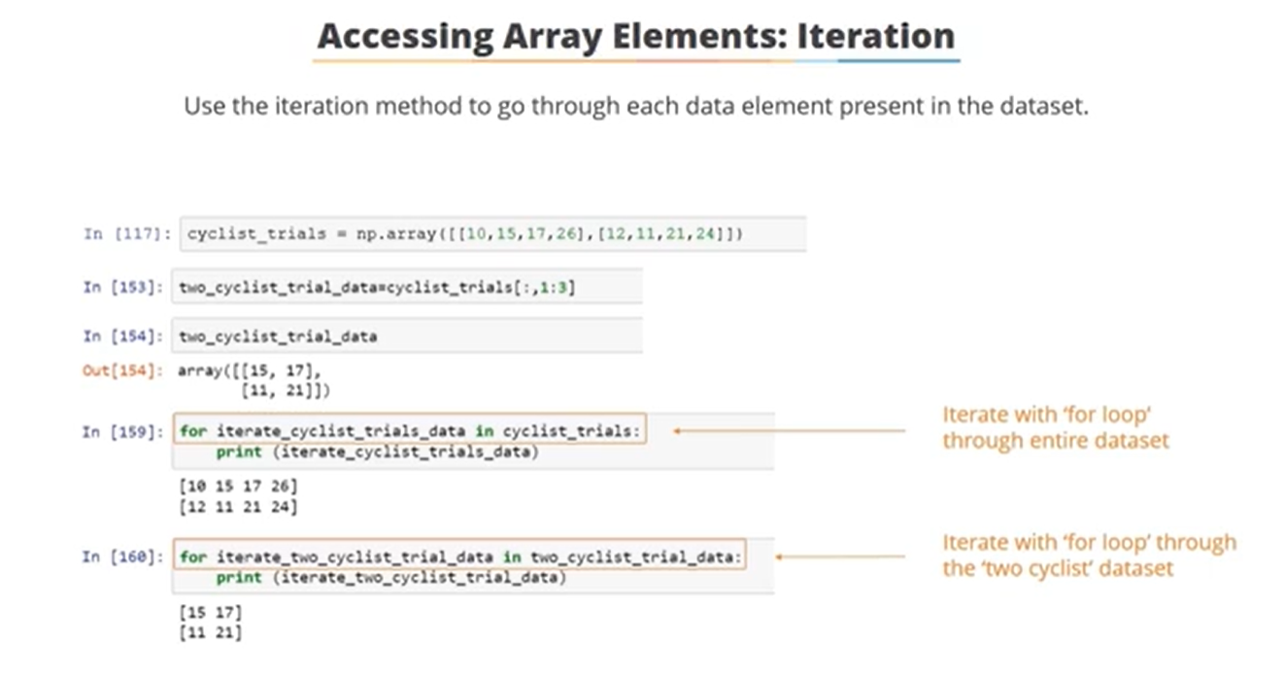

Slide 52
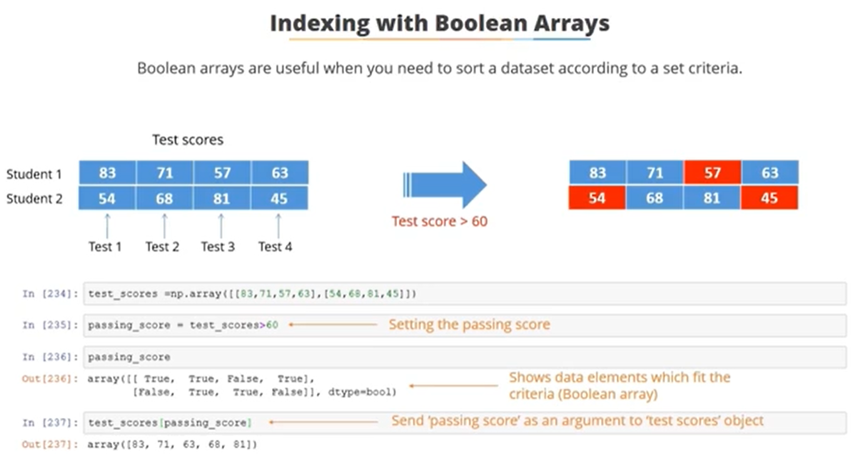

Slide 53
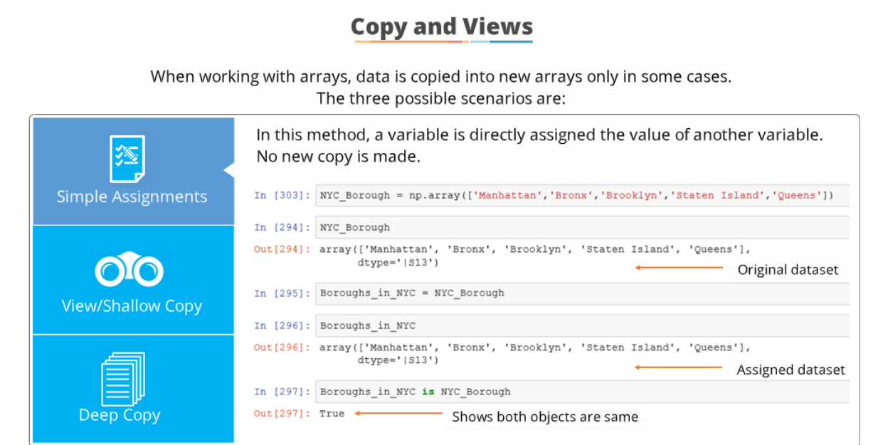

Slide 54
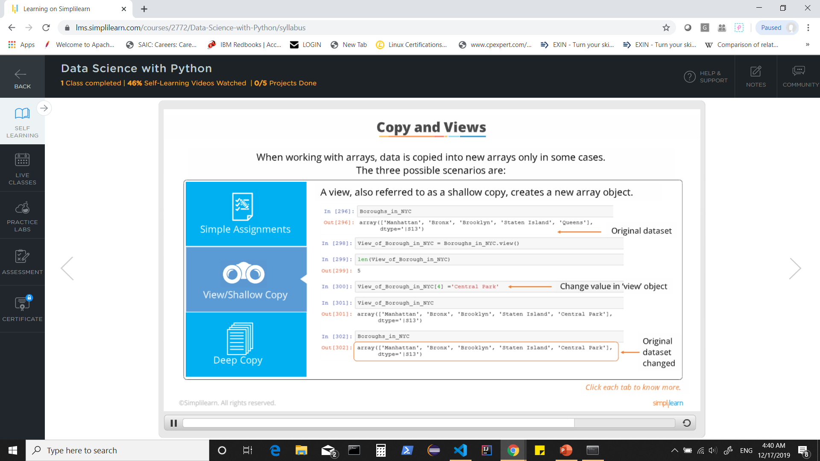

Slide 55
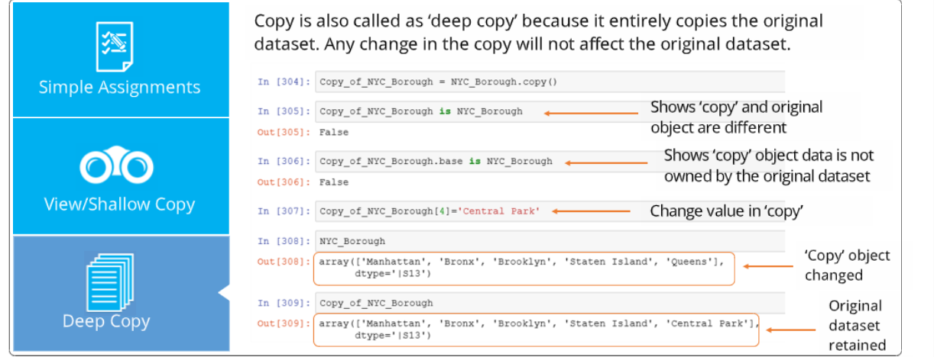

Slide 56
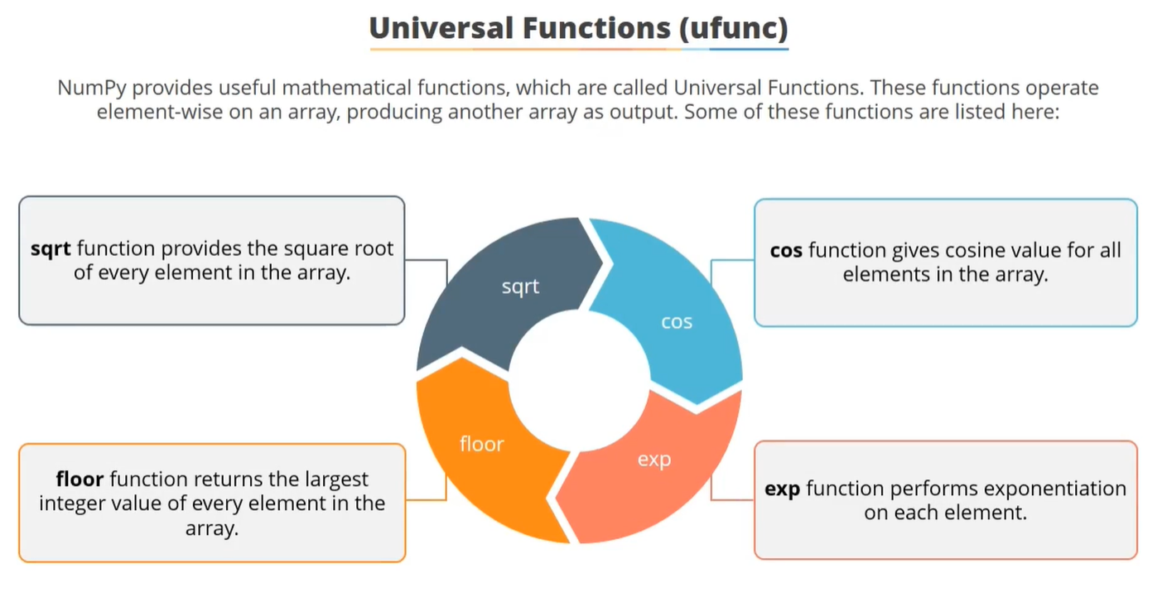

Slide 57
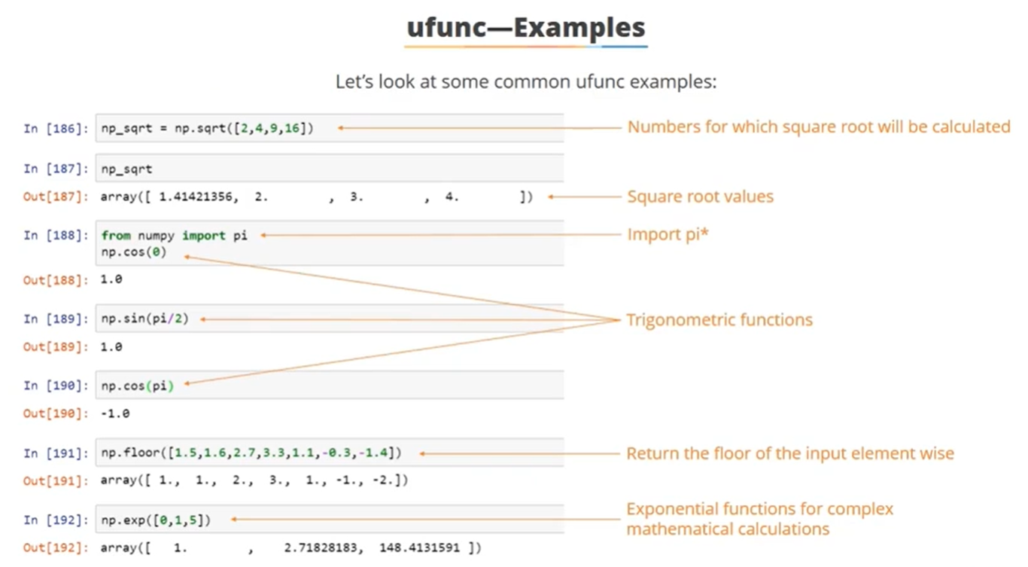

Slide 58
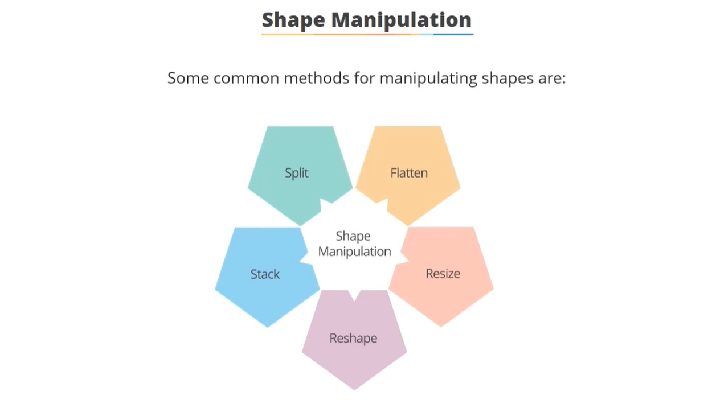

Slide 59
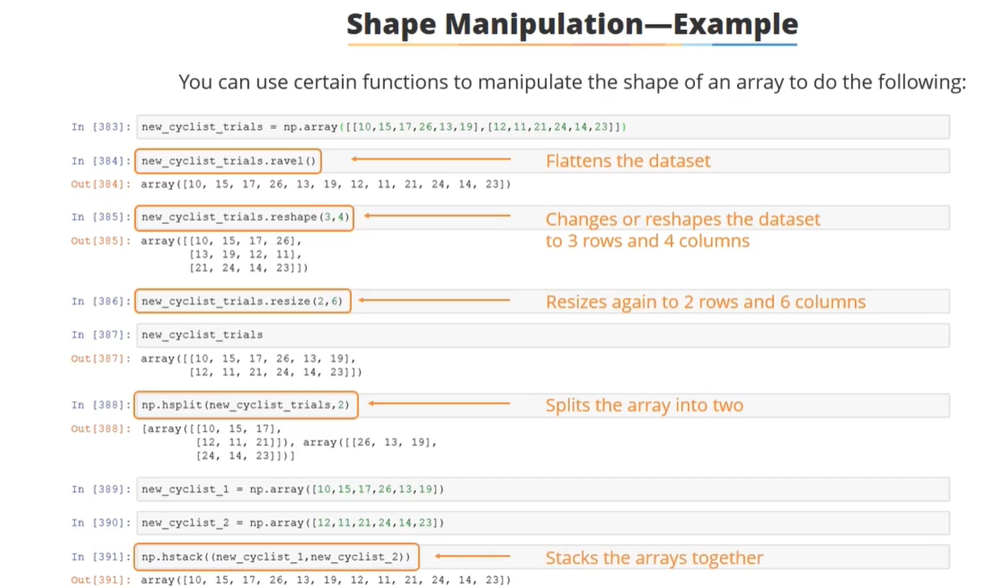

Slide 60
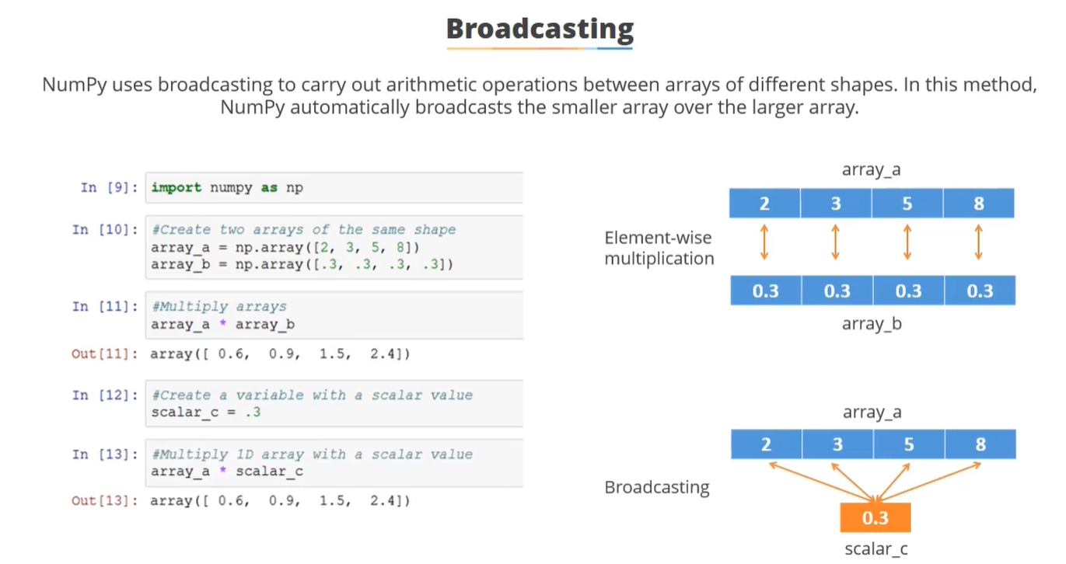

Slide 61
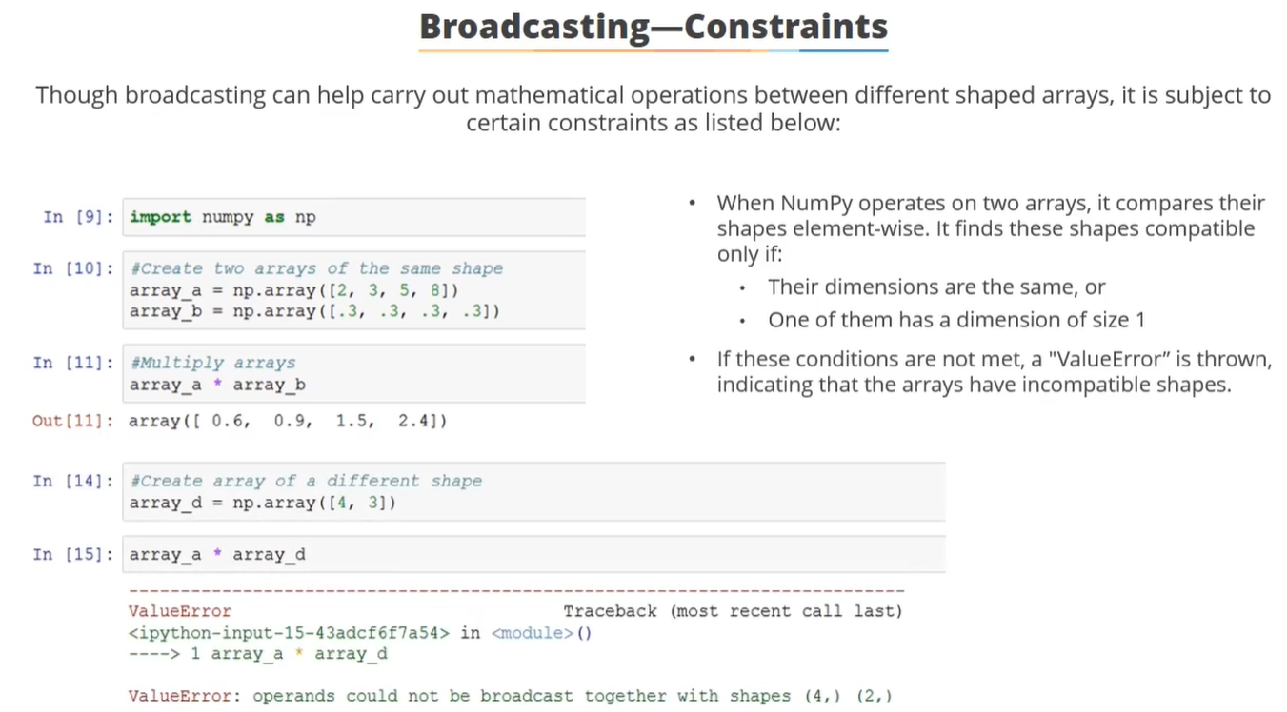

Slide 62
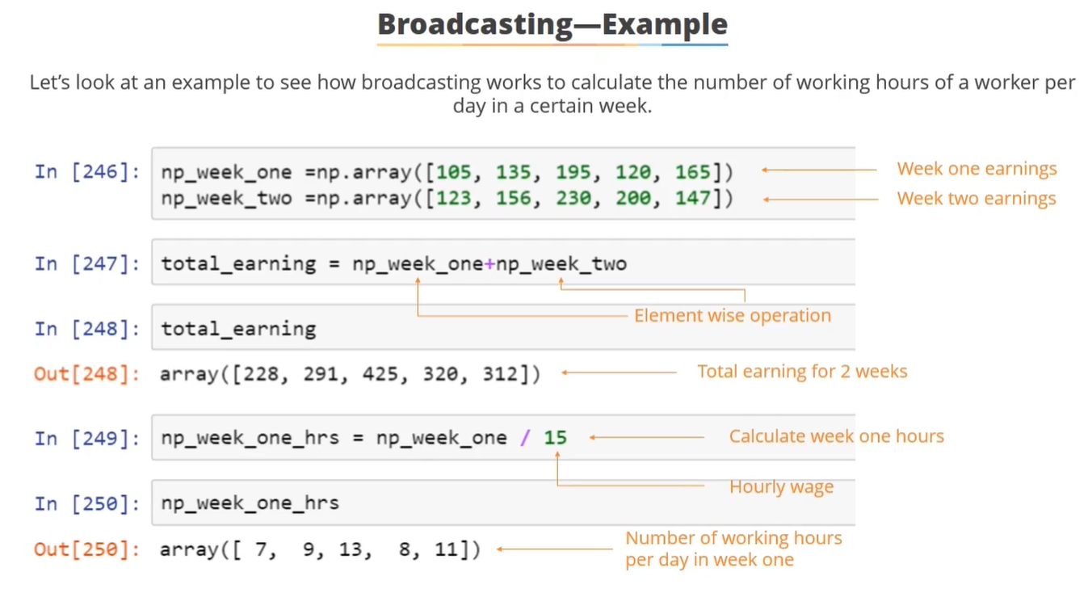

Slide 63
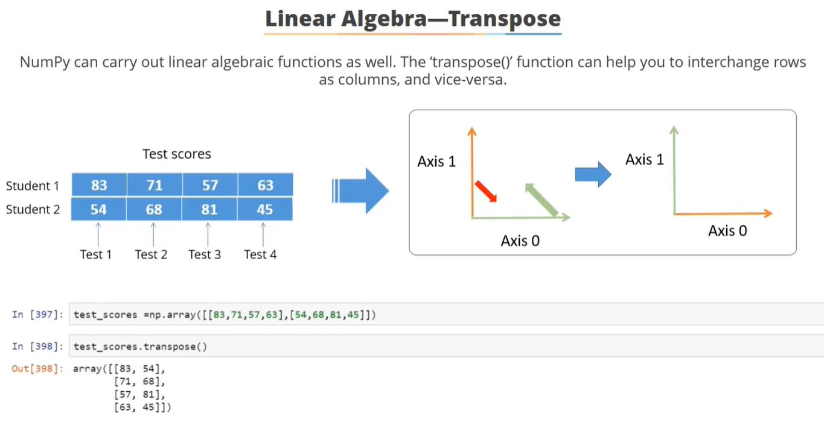

Slide 64
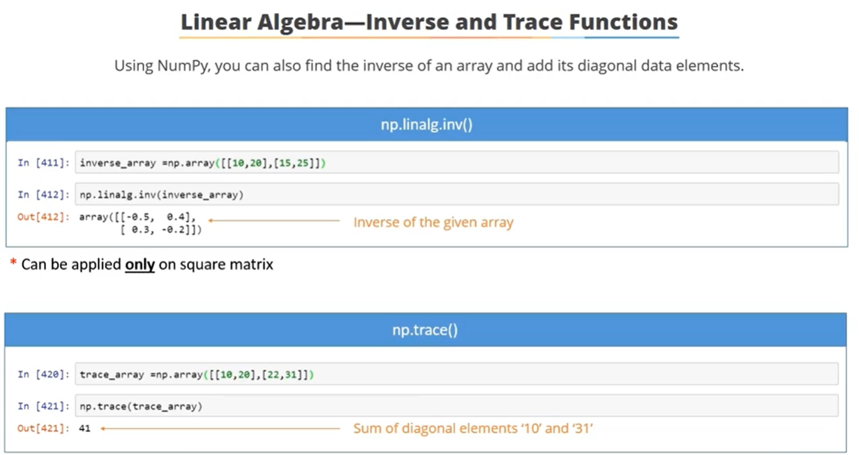
Notes:
Inversing only possible only on square matrix.
Trace is only for diagonals and its in increment and only applied left to right.

Slide 65
Examples:
https://github.com/ajaykuma/PythonCodes/tree/master/Numpy

Slide 66
PANDAS

Slide 67
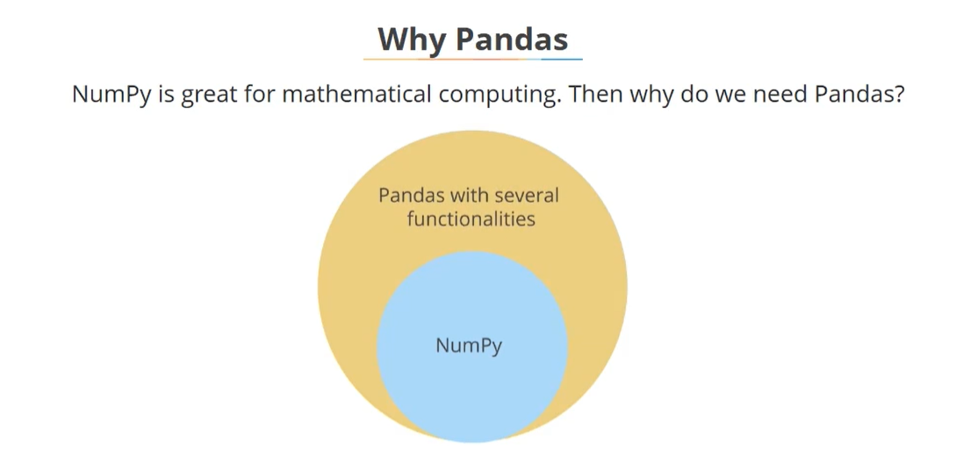
Pandas : One of the most Important tools used in industry for Data Analysis
Notes:
Numpy is still a low level tool when it comes to data munging.

Slide 68
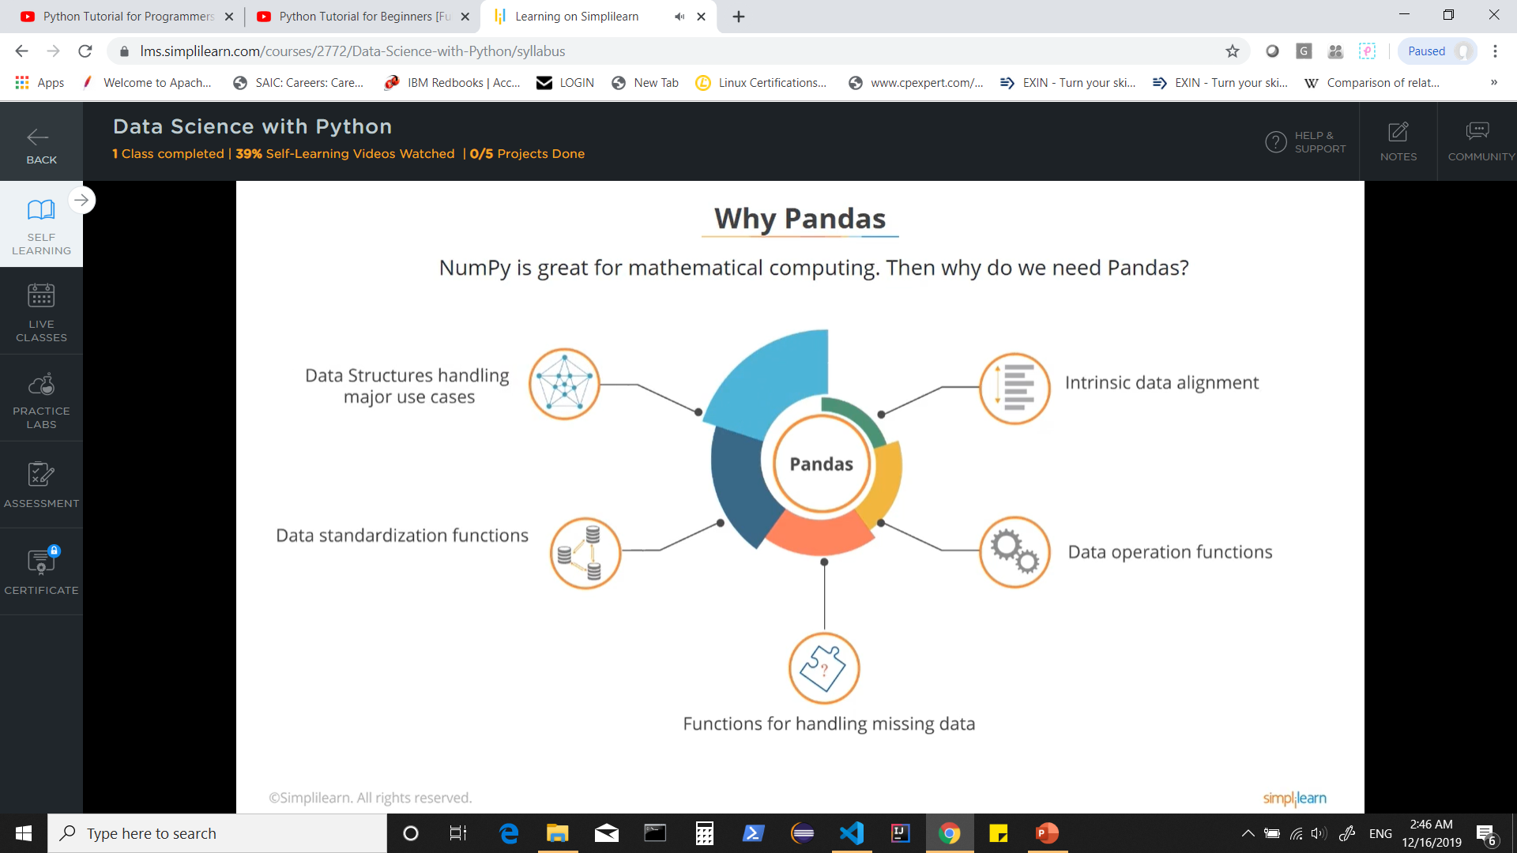
Two Primary Data Structures of Pandas:
Series ( one dimensional)
DataFrames ( two dimensional)
Merge
GroupBy
Join etc..
(Good for Data Wrangling & Manipulation)
Merge
GroupBy
Joins
(Good for Data Wrangling & Manipulation

Slide 69
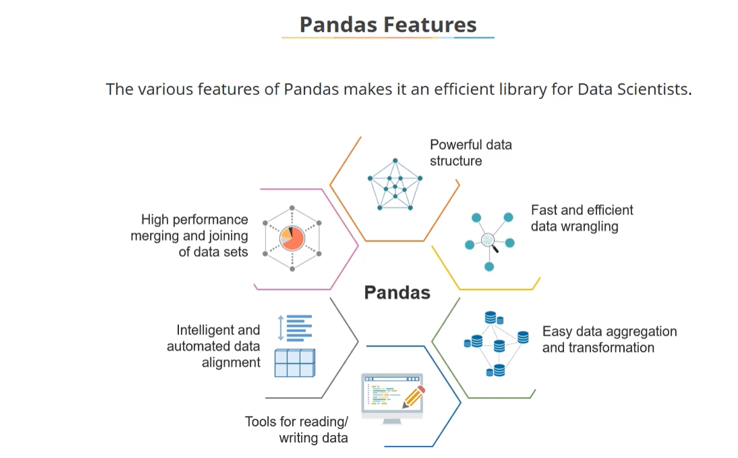
Notes:
Pandas : Has powerful data structures such as series or Data Frames
Built on top of Numpy , thus its fast and efficient for Data Wrangling
Its functions and methods make Data aggregation and transformation easier.
Has tools for reading and writing data in various data structures.
Data alignment through labeling is intelligent and automated mechanism.
Its libraries and functions are highly performance driven.

Slide 70
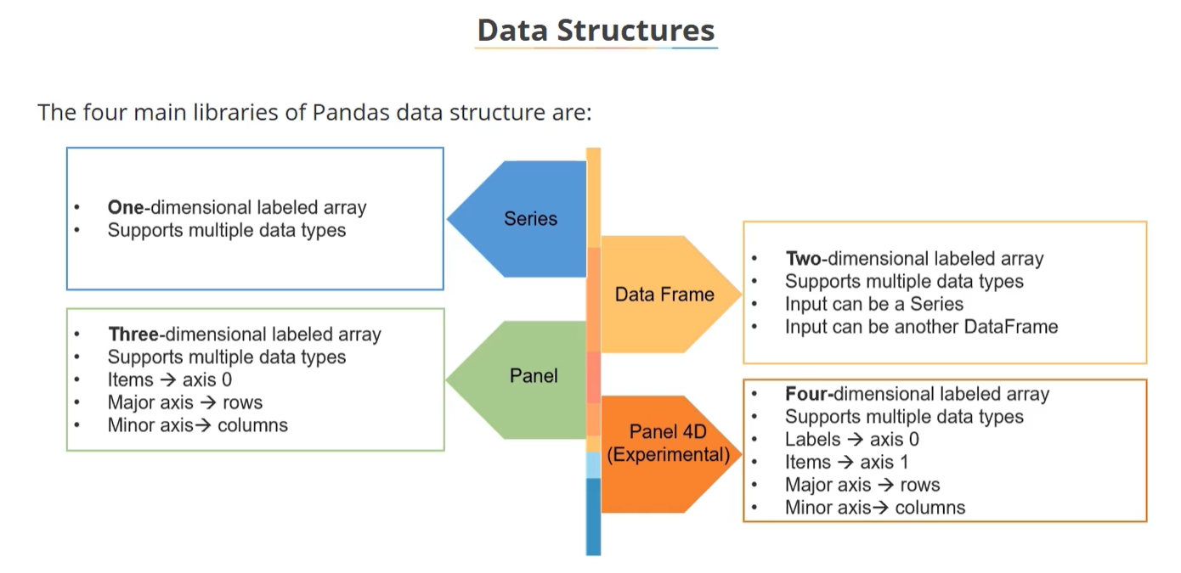
Notes:
Series: Can be visualized as a single row dataset. Supports multiple data types such as integer, string, float etc.
Data Frame: Can be visualized as a typical spreadsheet structure or a sql table. Supports multiple data types such as integer, string, float etc.
Panel : Mainly used to represent and wrangle 3 dimensional datasets. Can be visualized as x,y, and z axis.
Panel 4D:

Slide 71


Slide 72

Notes:
Ndarray – can be used as an input to create Pandas Series. Recommended when dataset is number centric and requires complex numerical computing.
Dict : Pandas series can be created using dictionary and its very efficient when it comes to indexing or re-indexing for data wrangling purposes. Dict works on key value pairs thus useful when data is structured as Key value pair.
Scalar : Another way to create series. It is a standalone quantity and works well with scalar and vector values.
List : Basic python data structure which can be used as input to create series.

Slide 73


Slide 74


Slide 75


Slide 76


Slide 77


Slide 78

Notes:
loc === look up method
look up using index position

Slide 79


Slide 80

Notes:
Handling Nan values is a challenge when no values provided for indices or new indices introduced.

Slide 81
Working with Series

Slide 82
Series
A Series is a one-dimensional array-like object containing an array of data (of any NumPy data type) and an associated array of data labels, called its index. The simplest Series is formed from only an array of data
#Series
ser = Series([4, 7, -5, 3])
print(ser)
Index on the left and the values on the right.
#You can get the array representation and index object of the Series via its values and index attributes
print(ser.values)
print(ser.index)

Slide 83
#to create a Series with an index identifying each data point
ser2 = Series([4, 7, -5, 3], index=['d', 'b', 'a', 'c'])
ser2.index
print(ser2.index)
#manipulating and accessing values of series
ser2['a']
ser2['d'] = 6
ser2[['c', 'a', 'd']]
#NumPy array operations, such as filtering with a Boolean array, scalar multiplication, or applying math functions, preserve the index-value link #Note the unchanged index values
ser2
ser2[ser2 > 0]
ser2 * 2
np.exp(ser2)

Slide 84
#Series is a fixed-length, ordered dict, as it is a mapping of index values to data values.
'b' in ser2
'e' in ser2
#Creating series from a dictionary
sdata = {'paris': 35000, 'germany': 71000, 'greece': 16000, 'norway': 5000}
ser3 = Series(sdata)
print(ser3)
#When only passing a dict, the index in the resulting Series will have the dict’s keys in sorted order
country = ['greece', 'paris', 'germany', 'norway']
ser4 = Series(sdata, index=country)
print(ser4)
#The isnull and notnull functions in pandas should be used to detect missing data
pd.isnull(ser4)
pd.notnull(ser4)
#Series also has these as instance methods
ser4.isnull()

Slide 85
#A critical Series feature for many applications is that it automatically aligns differently indexed
data in arithmetic operations:
ser3
ser4
ser3 + ser4
#Both the Series object itself and its index have a name attribute, which integrates with
other key areas of pandas functionality:
ser4.name = 'population'
ser4.index.name = 'country'
ser4
#A Series’s index can be altered in place by assignment
ser.index = ['Bob', 'Steve', 'Jeff', 'Ryan']
ser

Slide 86


Slide 87
DataFrame
A DataFrame represents a tabular, spreadsheet-like data structure containing an ordered collection of columns, each of which can be a different value type (numeric,string, boolean, etc.).
The DataFrame has both a row and column index; it can be thought of as a dict of Series (one for all sharing the same index).
Under the hood, the data is stored as one or more two-dimensional blocks rather
than a list, dict, or some other collection of one-dimensional arrays.

Slide 88


Slide 89


Slide 90


Slide 91


Slide 92


Slide 93


Slide 94


Slide 95

Notes:
Not common treated are seen as NAN

Slide 96


Slide 97


Slide 98


Slide 99


Slide 100


Slide 101


Slide 102


Slide 103


Slide 104


Slide 105
Working with DataFrames

Slide 106


Slide 107


Slide 108


Slide 109
What do you do when the file you are trying to consume is quite large? Say the file is several GB of data or larger?
Read in chunks of a file at a time, process it, then free it from memory so you can pull in and process another chunk until the whole massive file has been processed. Determine a suitable chunk size or simply read a line of a file at a time.

Slide 110
It contains high-level data structures and manipulation tools designed to make data analysis fast and easy in Python.
Pandas is built on top of NumPy and makes it easy to use in NumPy-centric applications.
In [1]: from pandas import Series, DataFrame
In [2]: import pandas as pd
To get started with pandas, you will need to get comfortable with its two workhorse data structures:
Series and DataFrame.

Slide 111
Working with Files

Slide 112
Python has a number of very useful file IO functionality in its standard library of built-in functions and modules. The built-in open() function is what you use to open a file object for either reading or writing purposes.
fp = open('path/to/file.txt', 'r')
The open() function takes in multiple arguments.
First : a positional string parameter representing the path to the file that should be opened.
Second : optional parameter is also a string which specifies the mode of interaction you intend for the file object being returned by the function call. Default is 'r' for reading.
Mode Description
r Open for reading plain text
w Open for writing plain text
a Open an existing file for appending plain text
rb Open for reading binary data
wb Open for writing binary data

Slide 113
The file object returned from open() has three common explicit methods (read, readline, and readlines) to read in data and one more implicit way.
The read method will read in all the data into one text string. This is useful for smaller files where you would like to do text manipulation on the entire file, or whatever else suits you.
The readline method, which is one useful way to only read in individual line incremental amounts at a time and return them as strings.
The last explicit method, readlines, will read all the lines of a file and return them as a list of strings.

Slide 114
Pandas features a number of functions for reading tabular data as a DataFrame object.
Function Description
read_csv Load delimited data from a file, URL, or file-like object. Use comma as default delimiter
read_table Load delimited data from a file, URL, or file-like object. Use tab ('\t') as default delimiter
read_fwf Read data in fixed-width column format (that is, no delimiters)
read_clipboard Version of read_table that reads data from the clipboard. Useful for converting tables from web pages

Slide 115
Indexing: can treat one or more columns as the returned DataFrame, and whether
to get column names from the file, the user, or not at all.
Type inference and data conversion: This includes the user-defined value conversions and custom list of missing value markers.
Datetime parsing: includes combining capability, including combining date and
time information spread over multiple columns into a single column in the result.
Iterating: support for iterating over chunks of very large files.
Unclean data issues: skipping rows or a footer, comments, or other minor things
like numeric data with thousands separated by commas.

Slide 116
Continued in Part 2

Slide 117
Python - Date & Time

Slide 118
What is Tick?
Time intervals are floating-point numbers in units of seconds.
Particular instants in time are expressed in seconds since 12:00am, January 1, 1970(epoch).
There is a popular time module available in Python which provides functions for working with times, and for converting between representations.
The function time.time() returns the current system time in ticks since 12:00am, January 1, 1970(epoch).

Slide 119
import time # This is required to include time module.
ticks = time.time()
print "Number of ticks since 12:00am, January 1, 1970:", ticks
Index | Field | Values
0 | 4-digit year | 2008
1 | Month | 1 to 12
2 | Day | 1 to 31
3 | Hour | 0 to 23
4 | Minute | 0 to 59
5 | Second | 0 to 61 (60 or 61 are leap-seconds)
6 | Day of Week | 0 to 6 (0 is Monday)
7 | Day of year | 1 to 366 (Julian day)
8 | Daylight savings | -1, 0, 1, -1 means library determines DST
What is Time Tuple?
Many of Python's time functions handle time as a tuple of 9 numbers, as shown

Slide 120
Tuple’s is equivalent to struct_time structure.
Index | Attributes | Values
0 | tm_year | 2008
1 | tm_mon | 1 to 12
2 | tm_mday | 1 to 31
3 | tm_hour | 0 to 23
4 | tm_min | 0 to 59
5 | tm_sec | 0 to 61 (60 or 61 are leap-seconds)
6 | tm_wday | 0 to 6 (0 is Monday)
7 | tm_yday | 1 to 366 (Julian day)
8 | tm_isdst | -1, 0, 1, -1 means library determines DST

Slide 121
Getting current time
To translate a time instant from a seconds since the epoch floating-point value into a time-tuple, pass the floating-point value to a function (e.g., localtime) that returns a time-tuple with all nine items valid.
import time
localtime = time.localtime(time.time())
print "Local current time :", localtime
import calendar
cal = calendar.month(2019, 1)
print "Here is the calendar:"
print cal
Getting formatted time
import time
localtime = time.asctime( time.localtime(time.time()) )
print "Local current time :", localtime

Slide 122
pandas.Timestamp
Pandas replacement for python datetime.datetime object.
Timestamp is the pandas equivalent of python’s Datetime and is interchangeable with it in most cases. It’s
the type used for the entries that make up a DatetimeIndex, and other timeseries oriented data structures in pandas.
Options
>>> pd.Timestamp(2017, 1, 1, 12)
Timestamp('2017-01-01 12:00:00')
>>> pd.Timestamp(year=2017, month=1, day=1, hour=12)
Timestamp('2017-01-01 12:00:00')
Notes:
https://docs.python.org/3/library/datetime.html#datetime.datetime

Slide 123
converts a datetime-like string
>>> pd.Timestamp('2017-01-01T12')
Timestamp('2017-01-01 12:00:00')
converts a float representing a Unix epoch in units of seconds
>>> pd.Timestamp(1513393355.5, unit='s')
Timestamp('2017-12-16 03:02:35.500000')
converts an int representing a Unix-epoch in units of seconds and for a particular timezone
>>> pd.Timestamp(1513393355, unit='s', tz='US/Pacific')
Timestamp('2017-12-15 19:02:35-0800', tz='US/Pacific')

Slide 124
Attributes
asm8 Return numpy datetime64 format in nanoseconds.
dayofweek Return day of the week.
dayofyear Return the day of the year.
days_in_month Return the number of days in the month.
daysinmonth Return the number of days in the month.
freqstr Return the total number of days in the month.
is_leap_year Return True if year is a leap year.
is_month_end Return True if date is last day of month.
is_month_start Return True if date is first day of month.
is_quarter_end Return True if date is last day of the quarter.
is_quarter_start Return True if date is first day of the quarter.
is_year_end Return True if date is last day of the year.
is_year_start Return True if date is first day of the year.
quarter Return the quarter of the year.
resolution Return resolution describing the smallest difference between two times that can be represented by Timestamp object_state
tz Alias for tzinfo
week Return the week number of the year.
weekday_name (DEPRECATED) .. deprecated:: 0.23.0
weekofyear Return the week number of the year.

Slide 125
Machine Learning

Slide 126

ML uses statistical and mathematical models and applies them to datasets. This process can be fully or semi-automated.

Slide 127

Observations : May contain one or more data points.
Features : Usually present as columns in spreadsheets/fields in files.

Slide 128

Machine Learning Approach

Slide 129

Identifying Use Case & Learning Model

Slide 130


Slide 131


Slide 132

Supervised Learning : A known dataset with observations, features & response is used to train a ML Algorithm. A predictive model that is built on top of this algorithm is used to predict response for a new dataset that has same features.

Slide 133
Unsupervised Learning : A known dataset with observations, features is used to train a ML Algorithm. A predictive model that is built on top of this algorithm is used to identify how to CLASSIFY & REPRESENT the data points for a new dataset that has same features.
Features + Domain expertise : We can make some assumptions to choose some features/attributes algorithm should watch out for aiming to identify, classify or visualize any new unseen data.
WE can then use Cross-validation to further train the model and test for accuracy.

Slide 134



Slide 135

Scikit Learn

Slide 136

Fit the data in model to train and test it
Choosing
the model
Represents the
model in scikit learn by importing the class and instantiating it
Use predict method to forecast on unseen dataset

Slide 137


Slide 138


Slide 139

Data generalization switches from categorical to regression.

Slide 140


Slide 141

In a multi-dimensional dataset, we need lot of data points to create its representative sample. Analytics on this might be very slow.

Slide 142

Notes:
Dimensionality reduction: Helps cut down the dimensions of a multi-dimensional dataset without loosing any data.
Drop columns that contain missing value and exceed some defined threshold values.
Data Variance indicates the changes in data value. If there are smaller changes in data, remove data lower than defined threshold after normalizing it.
Correlation shows how data points are related to each other.If highly correlated one set of points can be kept and others can be removed.
PCA : Statistical function that transforms the original dataset into a new set of coordinates by keeping highest possible variance to ensure there is significance loss in data.

Slide 143


Slide 144


Slide 145


Slide 146


Slide 147


Slide 148
Thread in Python
A thread is a lightweight process or task. A thread is one way to add concurrency to your programs. If your Python application is using multiple threads and you look at the processes running on your OS, you would only see a single entry for your script even though it is running multiple threads.
MultiThreading
Multithreading (simply "threading") is when a program creates multiple threads with execution cycling among them, so one longer-running task doesn’t block all the others. This works well for tasks that can be broken down into smaller subtasks, which can then each be given to a thread to be completed.

Slide 149
Difference:
With threading, concurrency is achieved using multiple threads, but due to the GIL only one thread can be running at a time. In multiprocessing, the original process is forked process into multiple child processes bypassing the GIL. Each child process will have a copy of the entire program's memory.
Relation:
Both multithreading and multiprocessing allow Python code to run concurrently. Only multiprocessing will allow your code to be truly parallel. However, if your code is IO-heavy (like HTTP requests), then multithreading will still probably speed up your code.

Slide 150
Threads
Running several threads is similar to running several different programs concurrently, but with the following benefits −
Multiple threads within a process share the same data space with the main thread and can therefore share information or communicate with each other more easily than if they were separate processes.
Threads sometimes called light-weight processes and they do not require much memory overhead; they are cheaper than processes.
A thread has a beginning, an execution sequence, and a conclusion. It has an instruction pointer that keeps track of where within its context it is currently running.
It can be pre-empted (interrupted)
It can temporarily be put on hold (also known as sleeping) while other threads are running - this is called yielding.

Slide 151

Notes:
The processor can switch between the threads whenever one of them is ready to do some work. Using the threading module in Python or any other interpreted language with a GIL can actually result in reduced performance. If your code is performing a CPU bound task, such as decompressing gzip files, using the threading module will result
in a slower execution time. For CPU bound tasks and truly parallel execution, we can use the multiprocessing module.
https://github.com/volker48/python-concurrency

Slide 152

Notes:
To use multiple processes, we can create a multiprocessing pool.
Note**The entire memory of the script is copied into each subprocess that is spawned. This can cause an issue.

Slide 153
Concurrency and Parallelism in Python Example 3: Distributing to Multiple Workers
While the threading and multiprocessing modules are great for scripts that are running on your personal computer, what should you do
if you want the work to be done on a different machine?
you need to scale up to more than the CPU on one machine can handle?
A great use case for this is long-running back-end tasks for web applications. If you have some long-running tasks, you don’t want to spin up a bunch of sub-processes or threads on the same machine that need to be running the rest of your application code. This will degrade the performance of your application for all of your users.
What would be great is to be able to run these jobs on another machine, or many other machines.

Slide 154

A great Python library for this task is RQ, a very simple yet powerful library. You first enqueue a function and its arguments using the library. This pickles the function call representation, which is then appended to a Redis list. Enqueueing the job is the first step, but will not do anything yet. We also need at least one worker to listen on that job queue.

Slide 155
Python Multithreading vs. Multiprocessing
If your code is IO bound, both multiprocessing and multithreading in Python will work for you. Multiprocessing is a easier to just drop in than threading but has a higher memory overhead.
If your code is CPU bound, multiprocessing is most likely going to be the better choice—especially if the target machine has multiple cores or CPUs.
For web applications, and when you need to scale the work across multiple machines, RQ is going to be better for you.

